Slide 1
Larimer 101
March 28, 2019
Property Taxes
The Larimer County
Treasurer’s Office
Irene Josey, Treasurer

Slide 2
“…in this world, nothing is certain except death and taxes.” - Benjamin Franklin, 1789

Slide 3
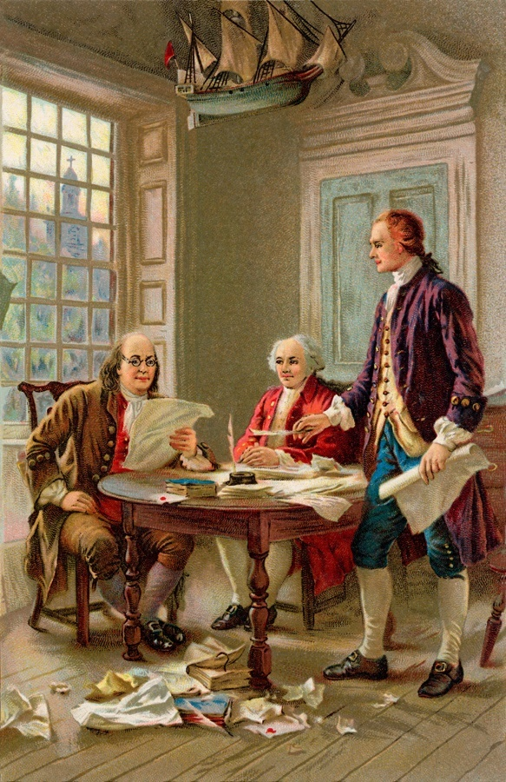
In a letter written on
November 13, 1789,
Benjamin Franklin stated:
“Our new Constitution is now established, everything seems to promise it will be durable; but, in this world, nothing is certain except death and taxes.”

Slide 4





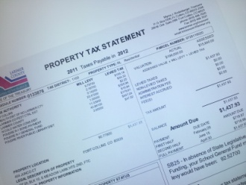
Our homes and business form the tax base from which taxes are derived to fund local governments and services
Property is assessed by the Assessor
Taxing Authorities use money collected to provide services to the citizens
The Larimer County
Property Tax Cycle
Taxing Authorities set the Mill Levy by which taxes are calculated
The Treasurer distributes the tax money collected to the Taxing Authorities
The taxpayer receives their Tax Statement in January
The Treasurer prepares the Tax Roll and mails out the statements

Slide 5

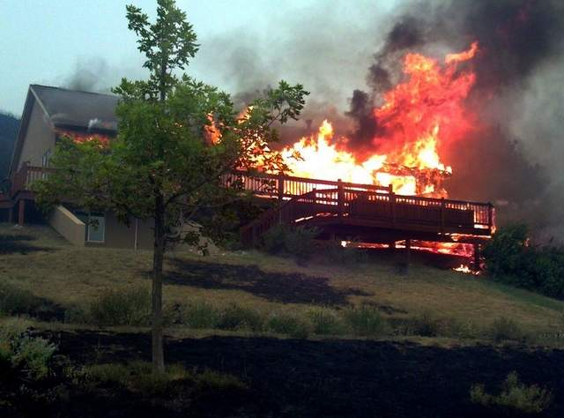
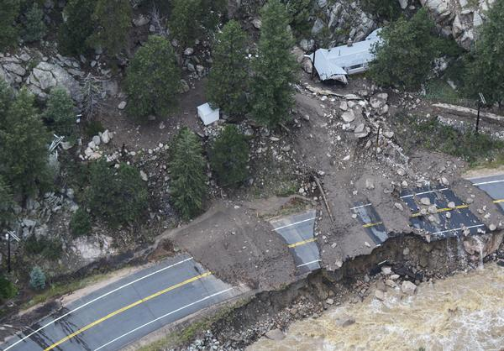
Property taxes have always been the financial mainstay of local governments in the United States and are much different than state or federal taxes.
Local governments have the ability to coordinate with local taxpayers to fund public services that directly benefit them. The taxes levied by Larimer County government, and the other entities in Larimer County, directly benefit the citizens in Larimer County.
The 2017 tax roll for taxes payable in 2018 is $451,052,172

Slide 6
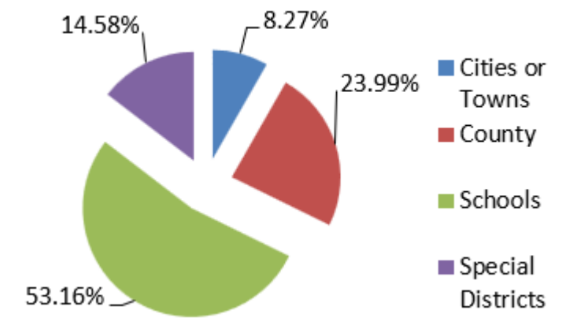
2018 Revenue Distribution
Schools 53.16%
Larimer County 23.99%
Special Districts 14.58%
Cities or Towns 8.27%

Slide 7
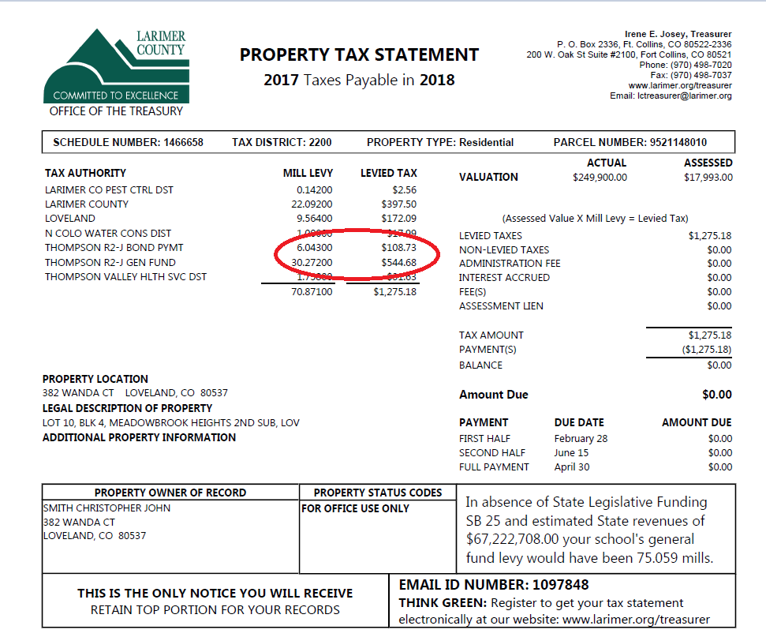

Slide 8
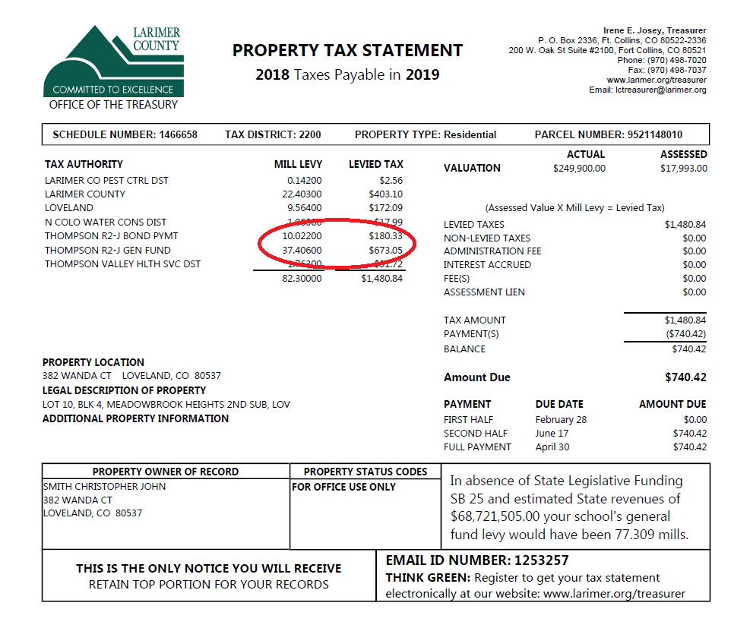

Slide 9
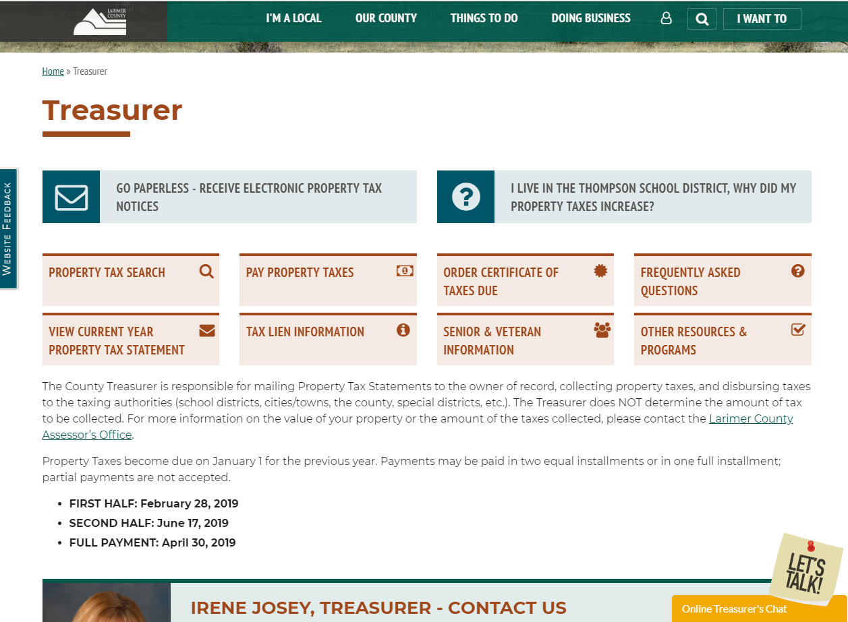

Slide 10
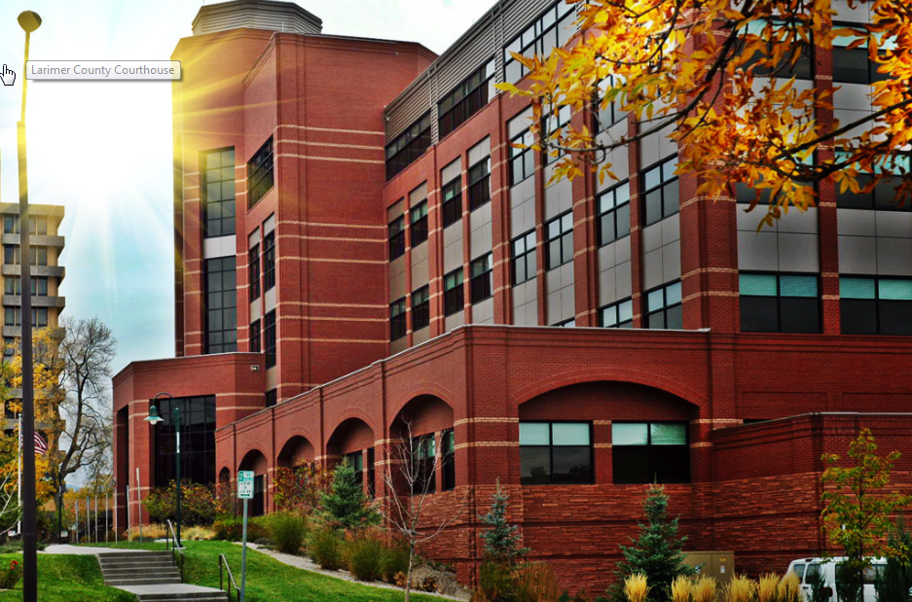
https://www.larimer.org/treasurer

Slide 11
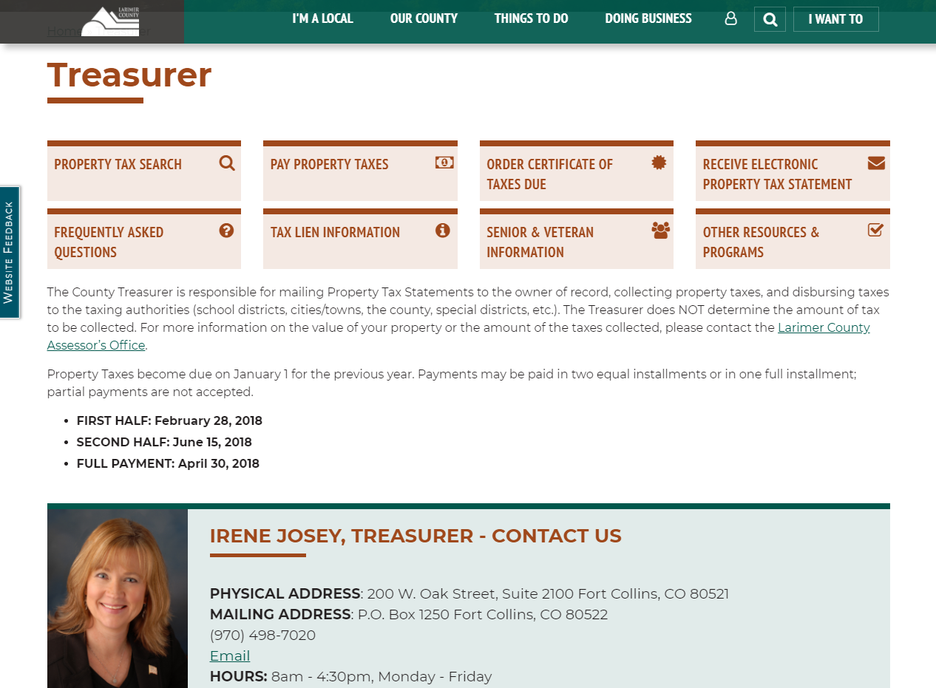
http://larimer.org/treasurer/

Slide 12
Where we WERE
and where we ARE
In 1986 - The Treasurer’s Office employed 14 staff members.
In 2018 - The Treasurer’s Office employs 13 staff members.
If you call the Treasurer’s Office, someone will answer the phone.
Walk in wait time is minimal to nonexistent, even on tax deadline days.
Safety of tax dollars, customer service and community trust are paramount. The economy and growth of the county have impacted our workload.
The Treasurer’s Office conducts surveys to ensure customer service is still meeting the expectations of the taxpayers and taxing authorities. Considering the growth of the county and no additional employees, it is important to continue to deliver a high-quality level of customer service.
Notes:
Most of the performance measures we currently report are statistics. Our future surveys will include questions that address, satisfaction with the accuracy of information provided, waiting time via phone or in line, courteousness of the staff, information on the website, happiness of the information provided to personal property owners, mobile home managers and taxing authorities. Because we are mandated, we feel the best measurements will be how well we provide the mandates and how much the public trusts the Treasurer’s Office.

Slide 13
Questions?

