Slide 1
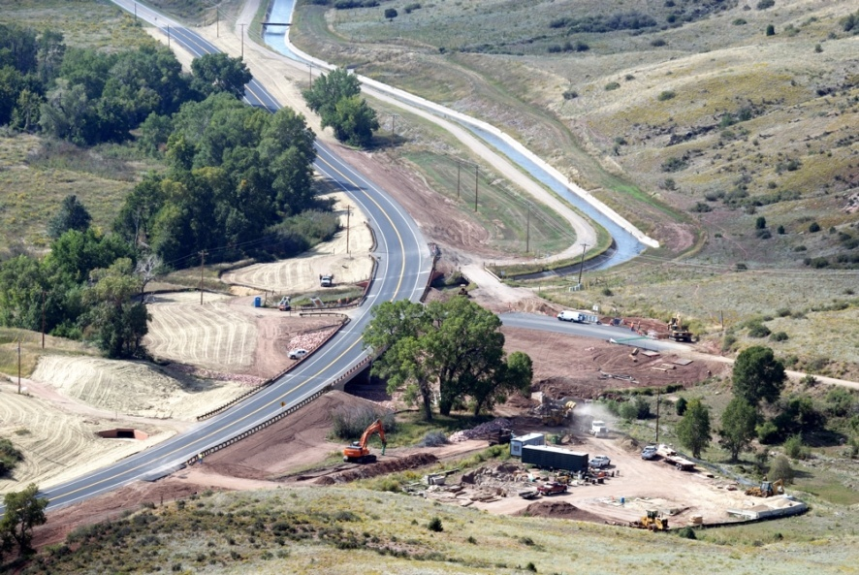
Engineering Department

Slide 2
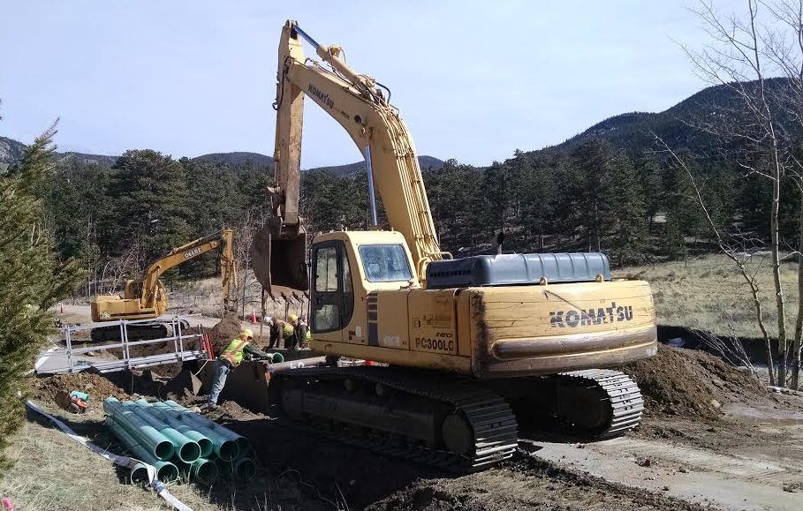
Who We Are & What We Do
33 staff – Variety of services provided
Provide a safe and efficient transportation system

Slide 3
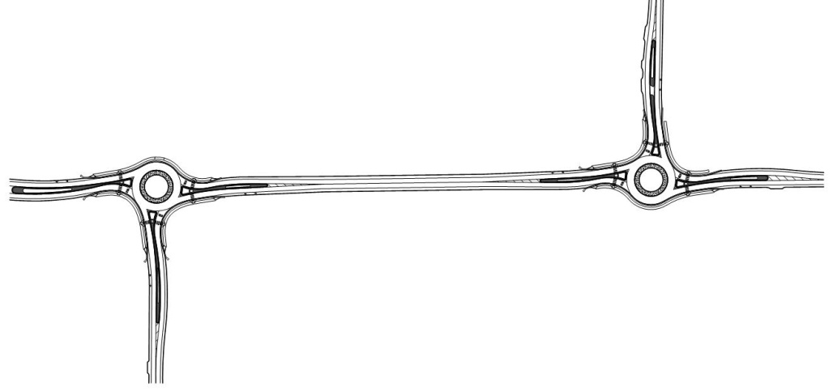
Capital Projects
Timberline Rd
CR 30
Add KYLE’s drwg
Boise Ave (CR 11C)

Slide 4
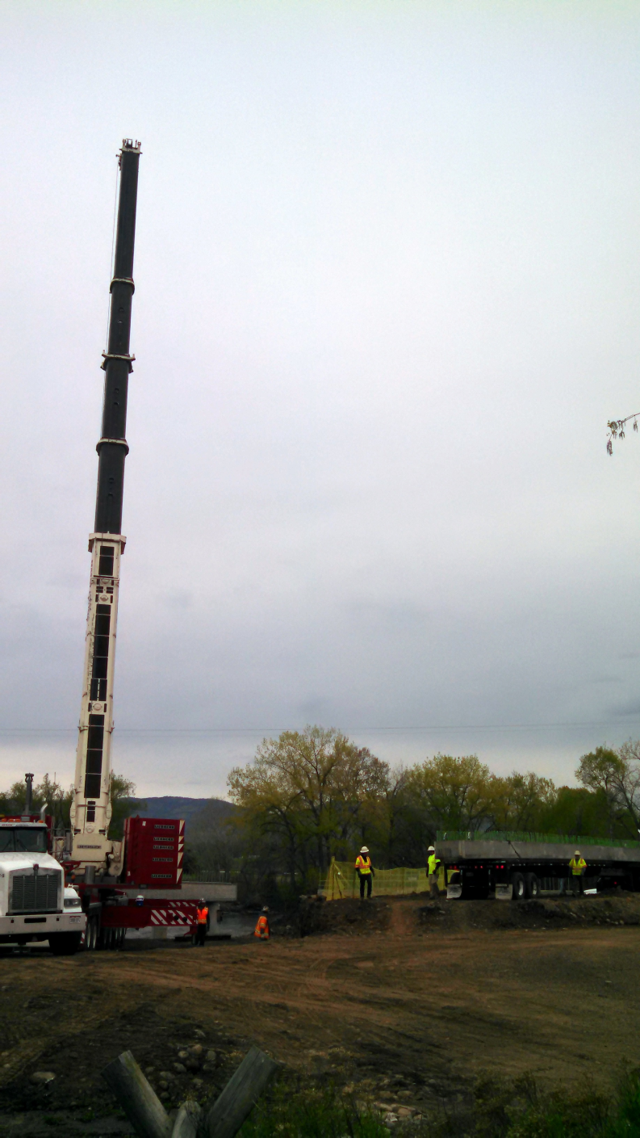
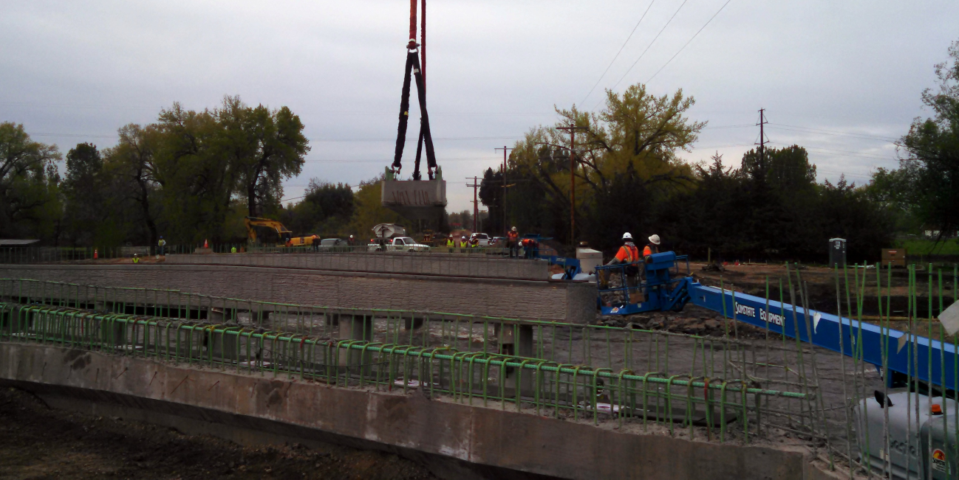
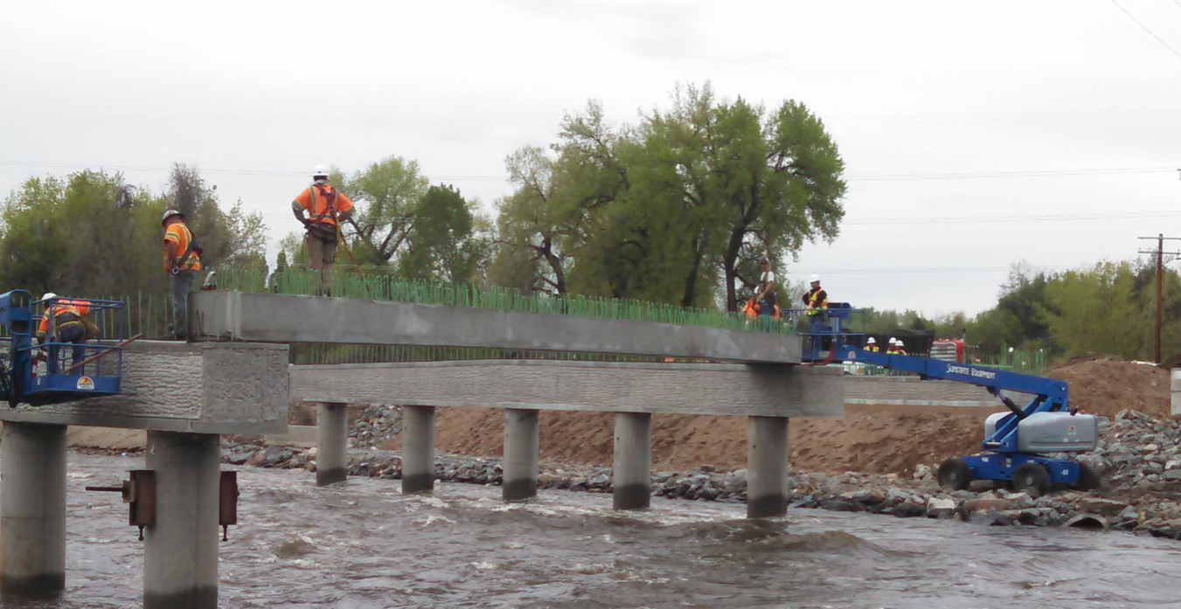
Capital Projects

Slide 5
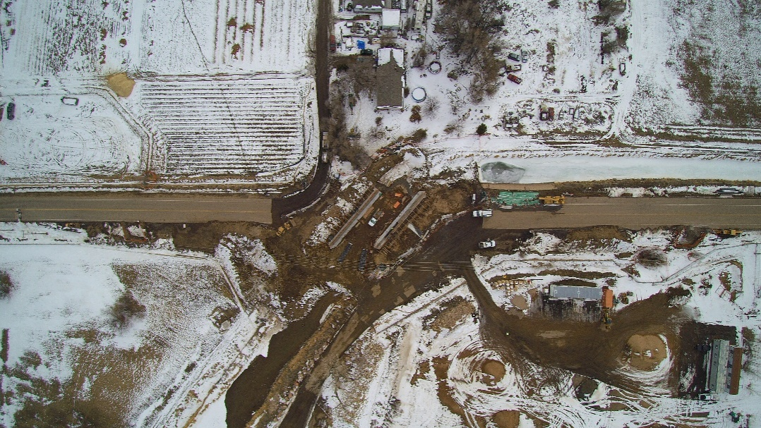
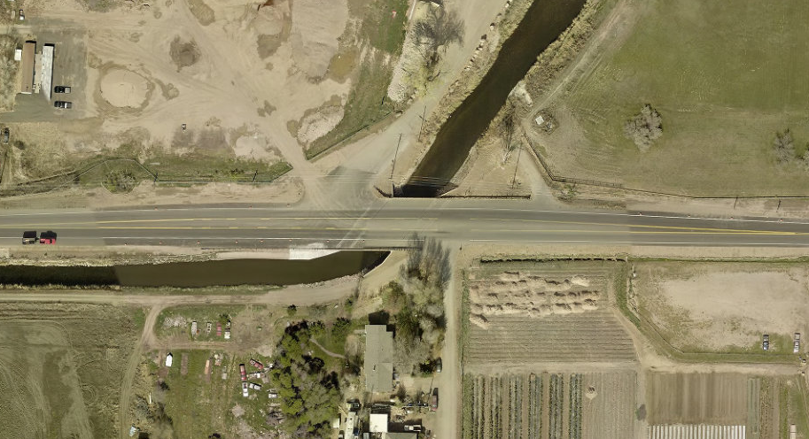
Capital Projects

Slide 6
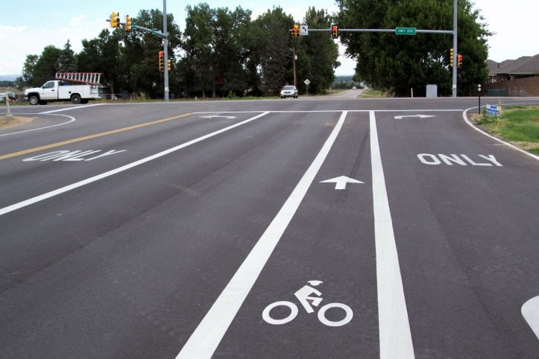
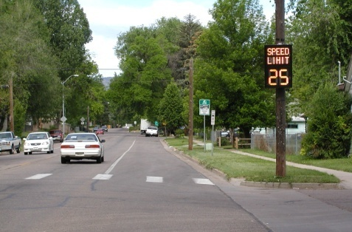
Transportation Planning/Operations
Transportation Master Plan
Safety Report
Signing and Striping
Speed Studies

Slide 7
Traffic Safety

Slide 8
Traffic Safety

Slide 9
Traffic Safety

Slide 10
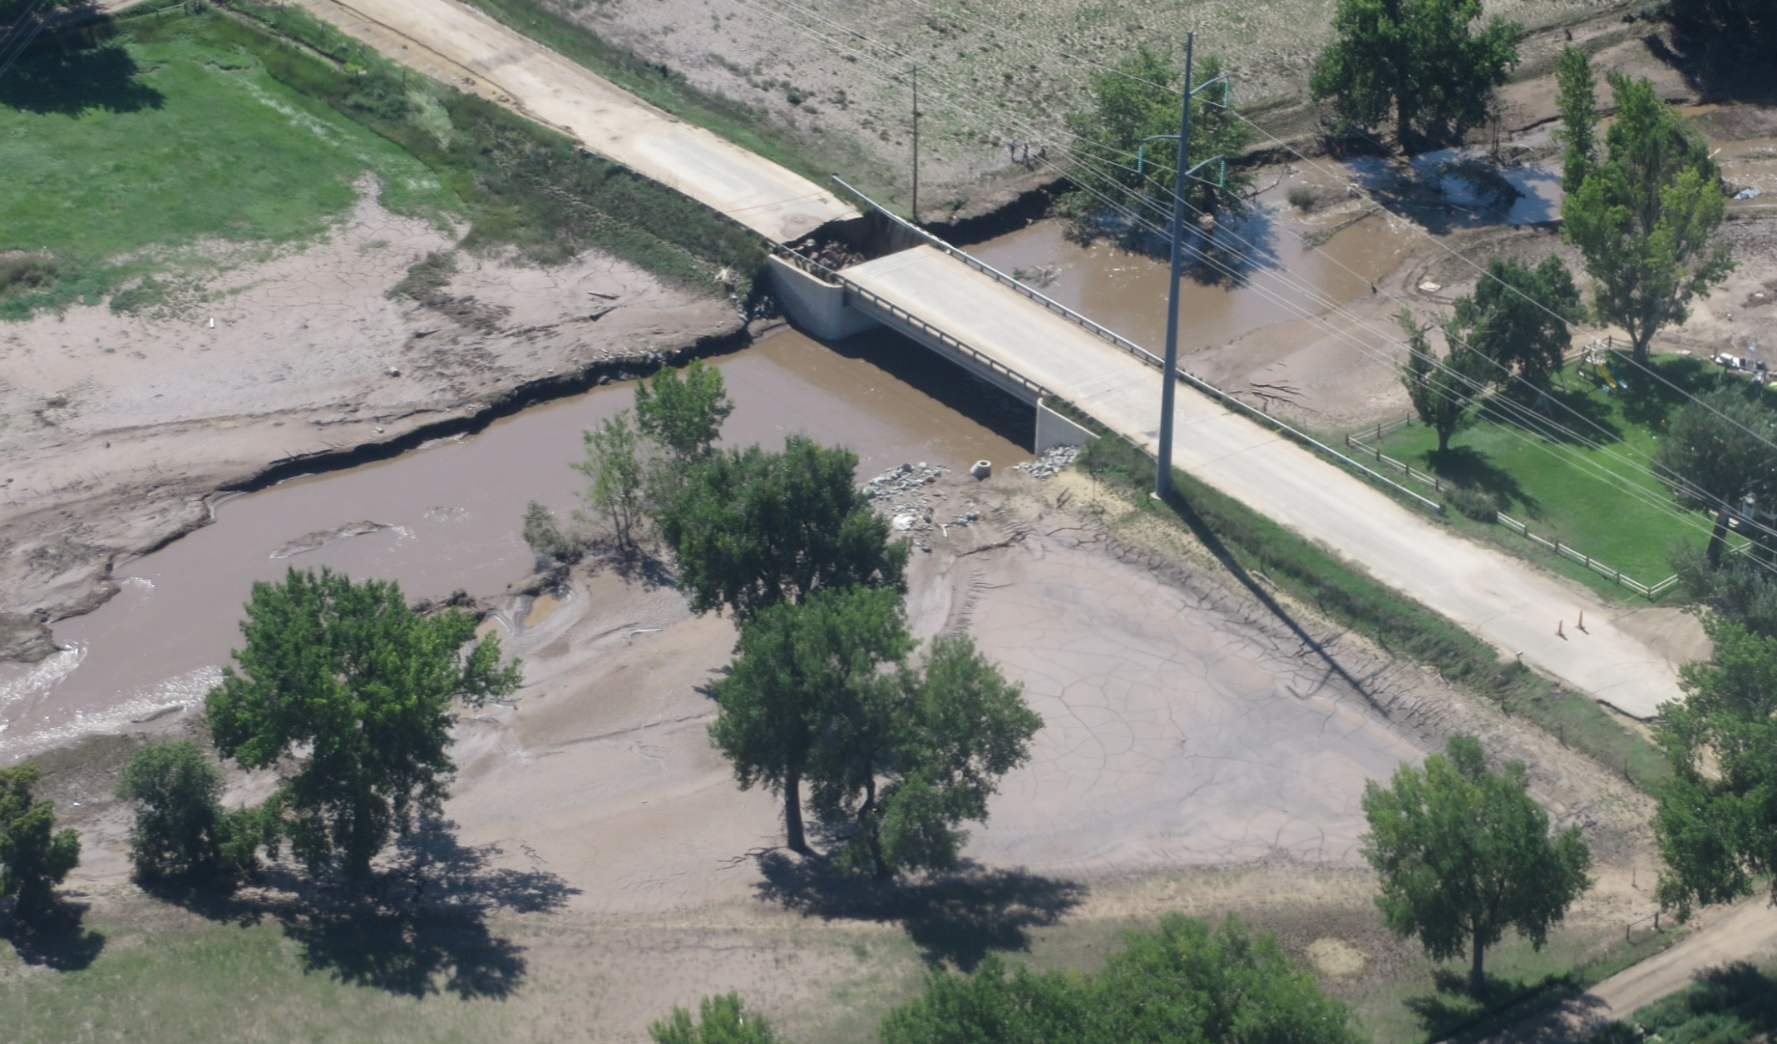
Development Review & Floodplain Administration
Review proposed development
Adhere to engineering standards for drainage and transportation impacts
Follow Federal Emergency Management Agency (FEMA) rules in and around floodplains

Slide 11
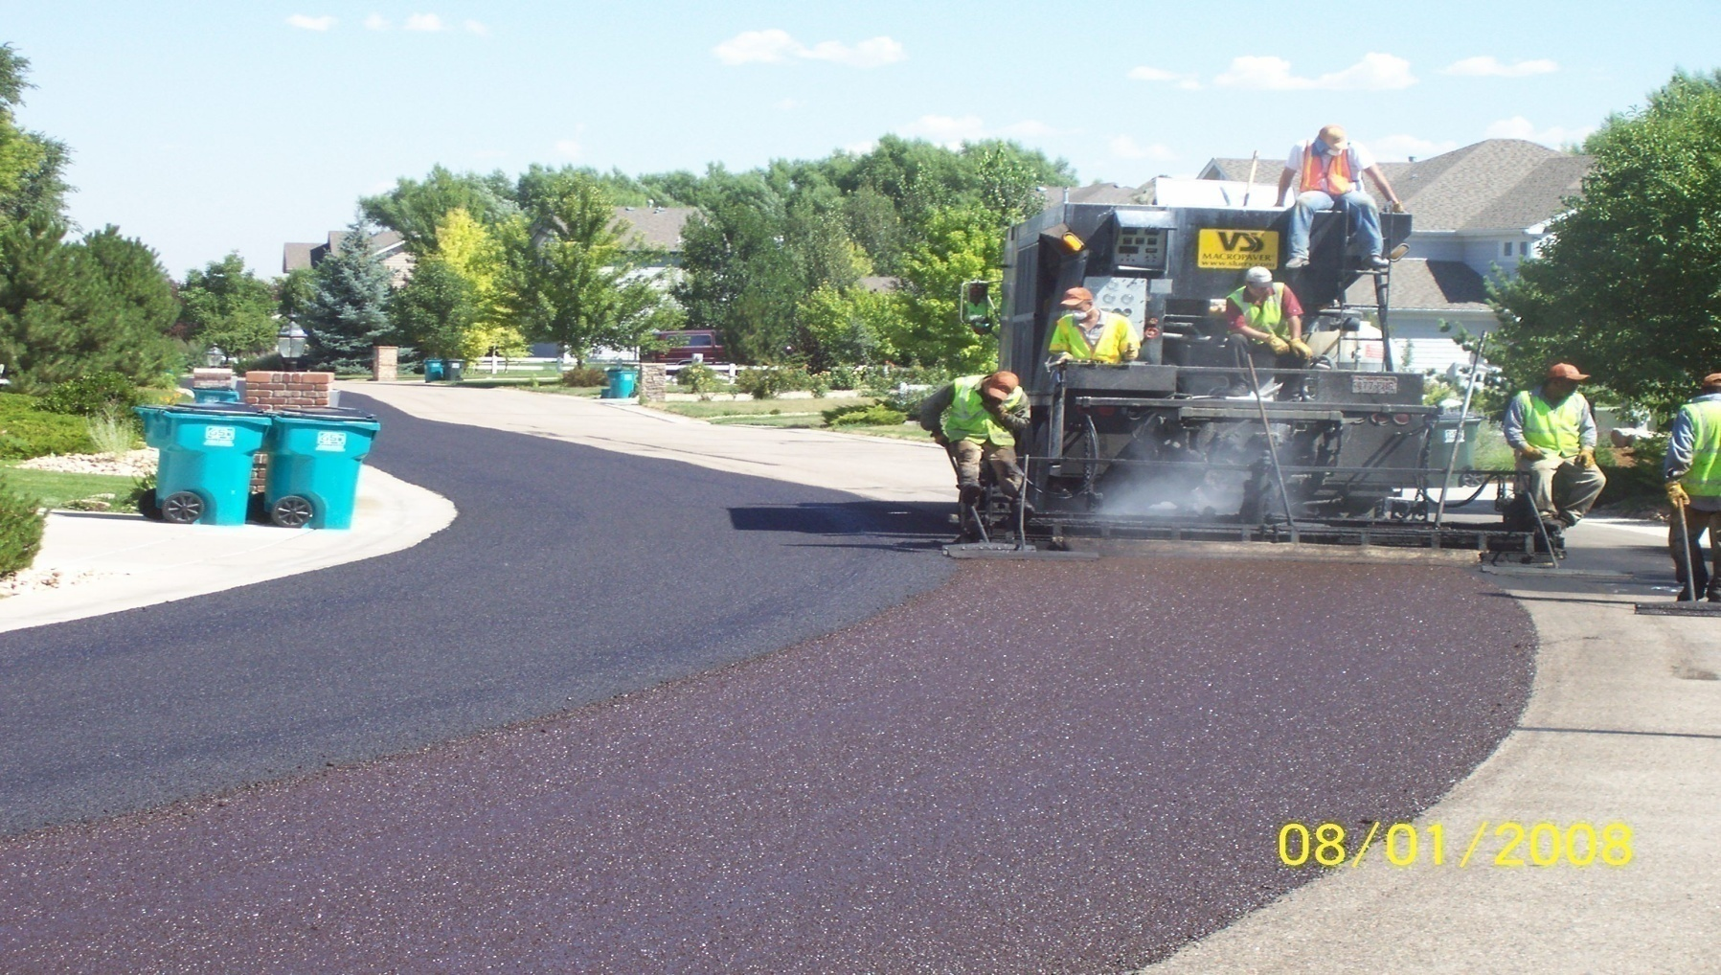
Public Improvement Districts
Maintenance of subdivision roads
Notes:
Why doesn’t the County maintain these roads?

Slide 12
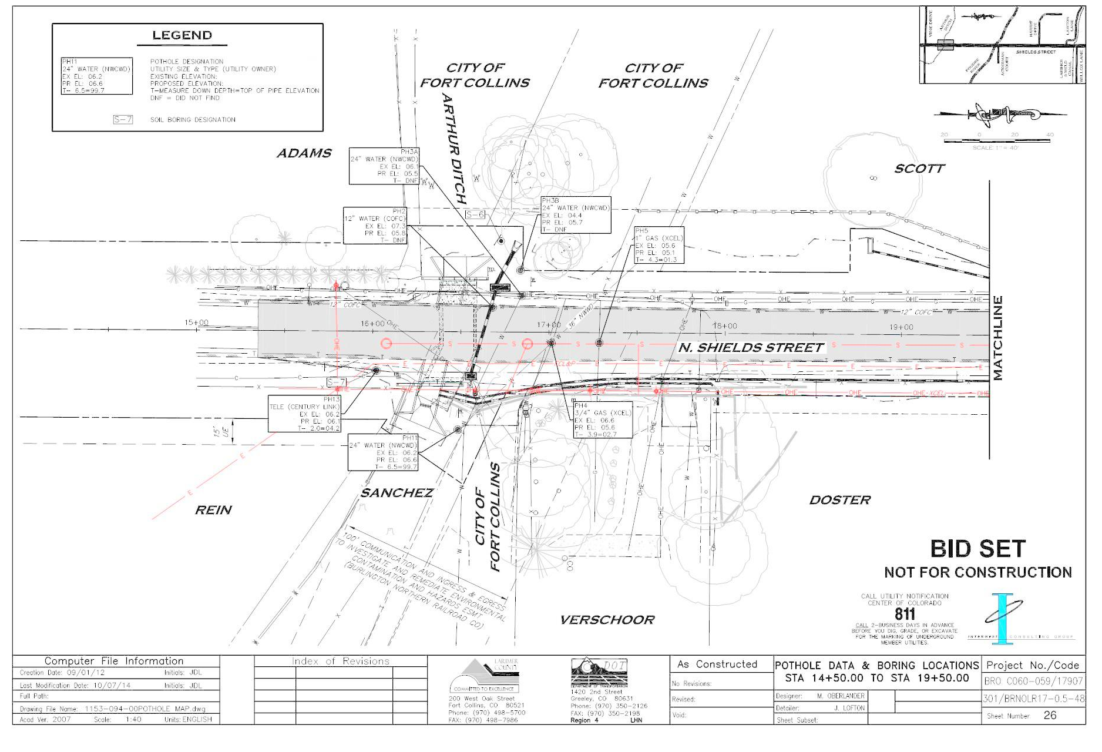
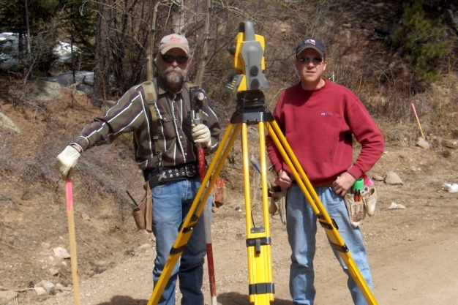
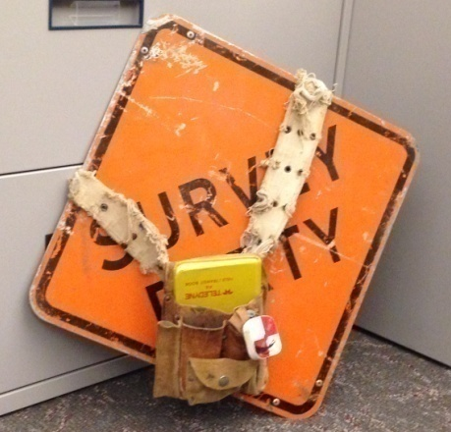
Surveying & Land Agents
Provide surveying for capital projects
Review plats for new development
Acquire right-of-way for capital projects
Acquire Open Space property

Slide 13
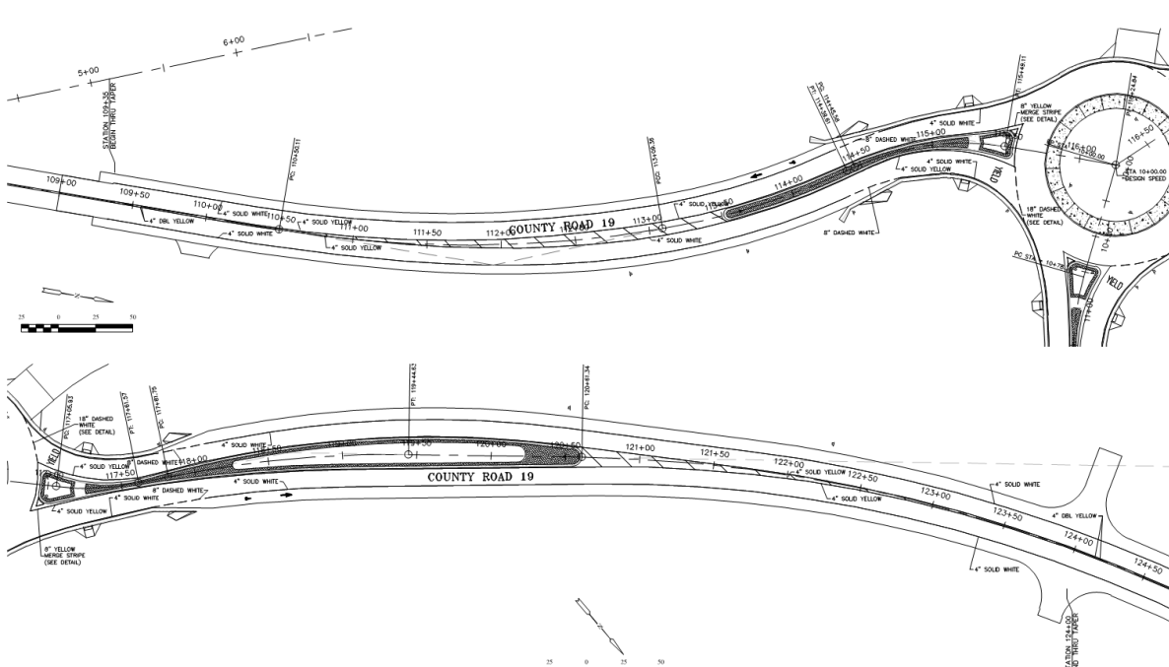
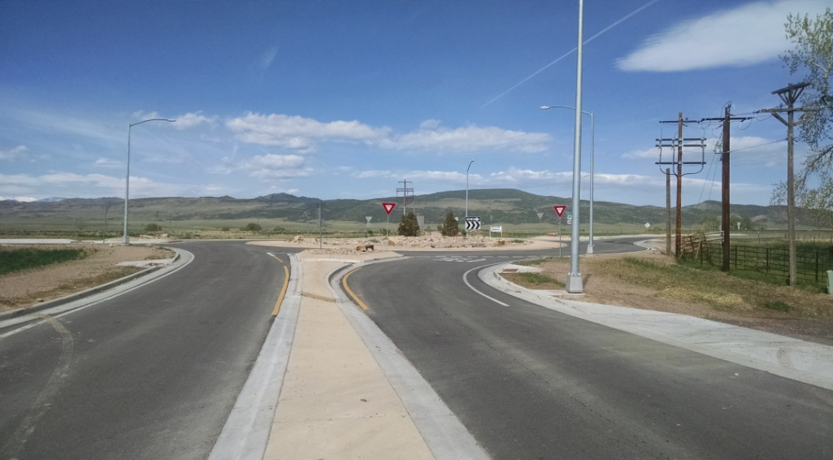
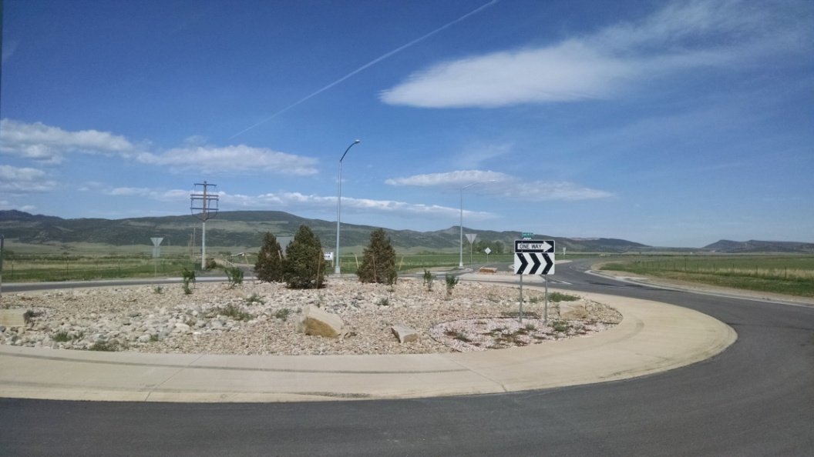
Construction Management
Construction Oversight
Access, Special Transport & Utility permits

Slide 14
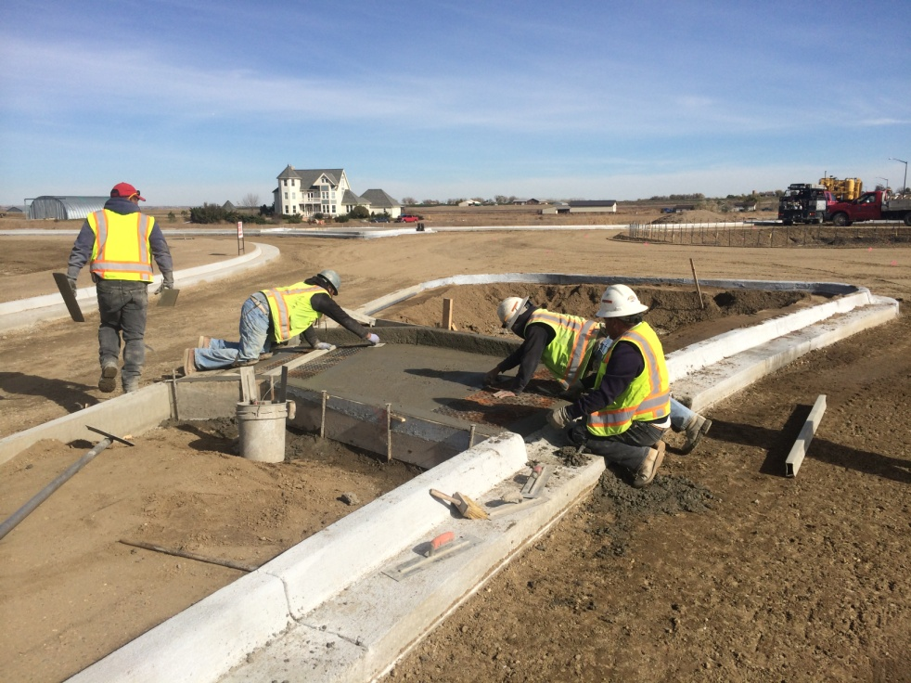
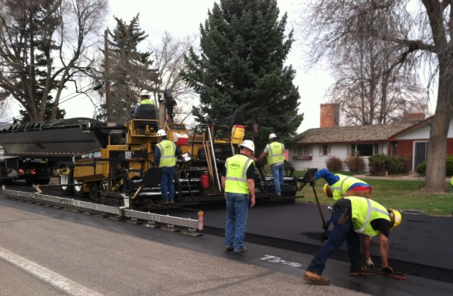
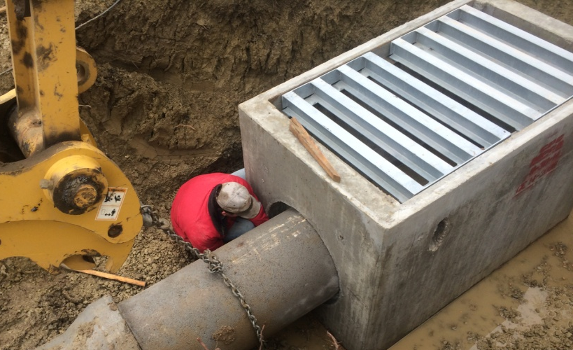
Road & Bridge
Annual overlay program
Structure maintenance coordination
Miscellaneous designs

Slide 15
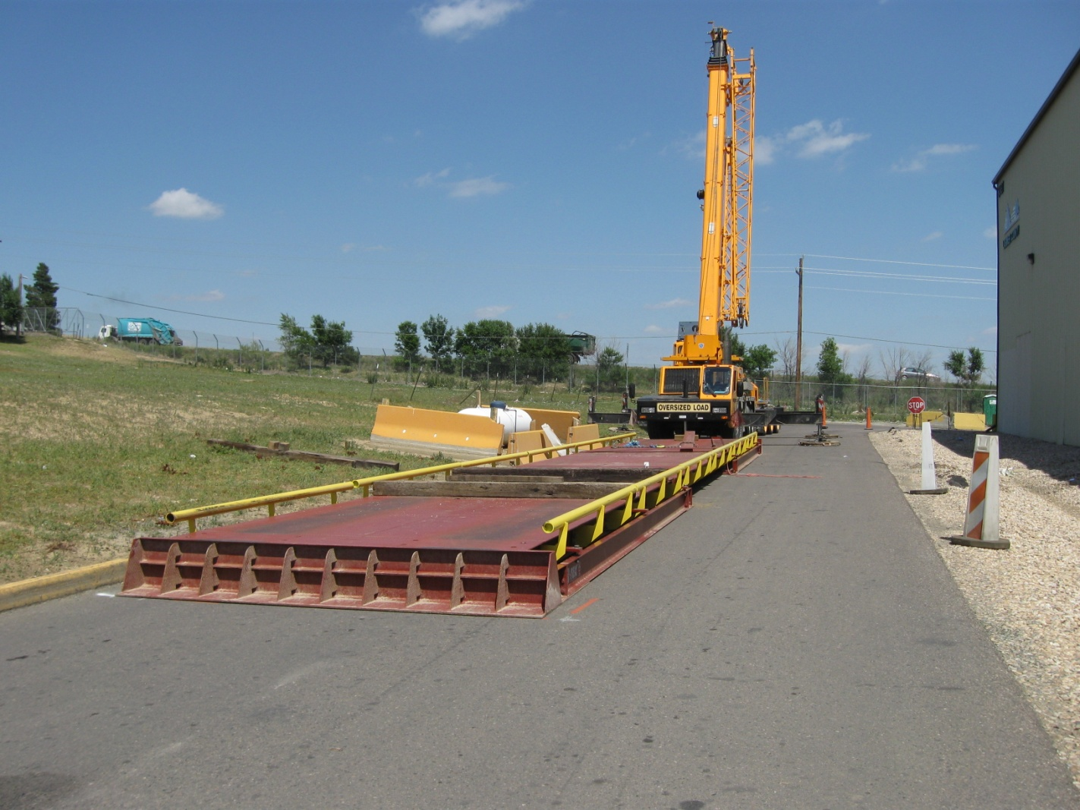
Solid Waste
Phased Closures
Scale installation

Slide 16
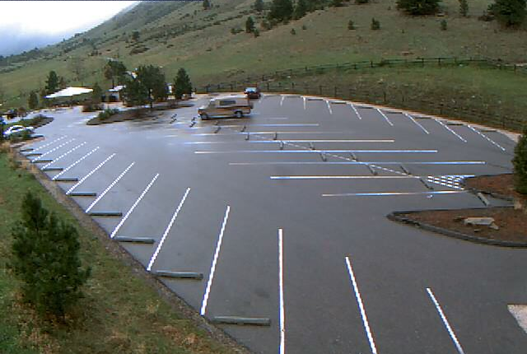
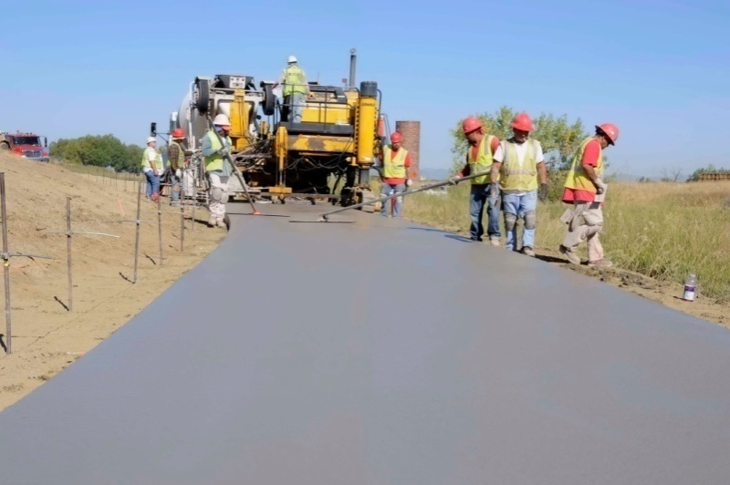
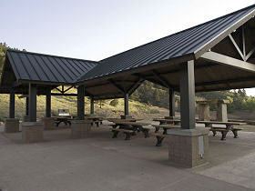
Natural Resources
Pinewood Reservoir Campground
Horsetooth Mountain Park Trailhead
Horsetooth South Bay Group Pavilions
River Bluffs Trail

Slide 17
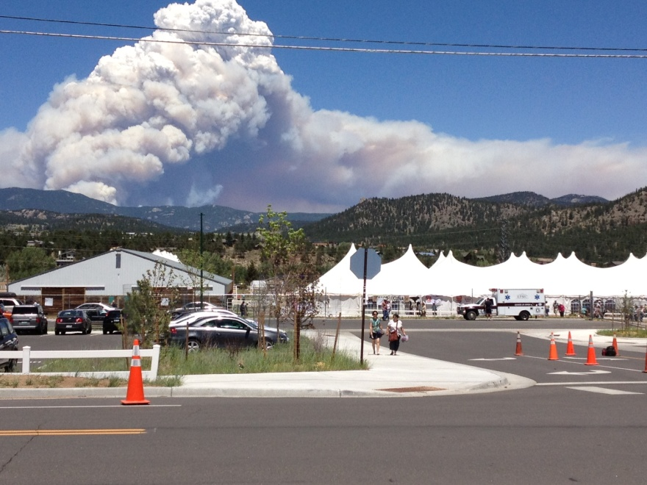
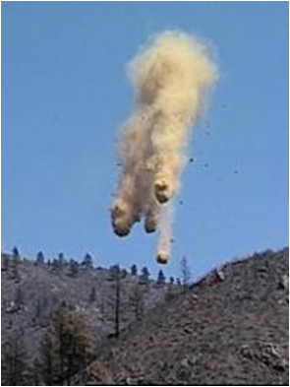
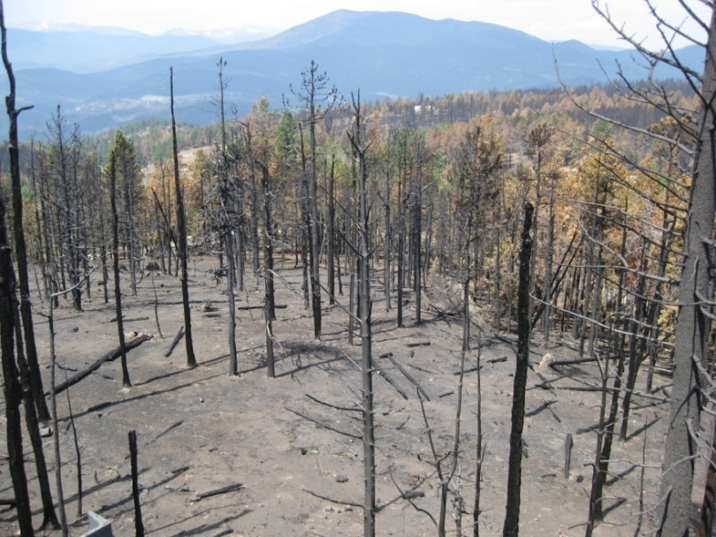
Natural Disasters
2012 High Park Fire
Close to 90,000 acres burned
Significant flooding issues
Aerial Mulching
Upsizing Culverts

Slide 18
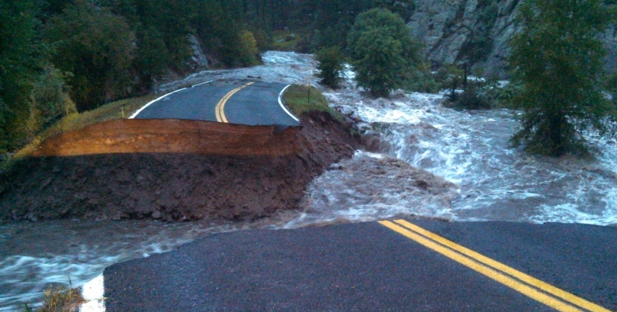
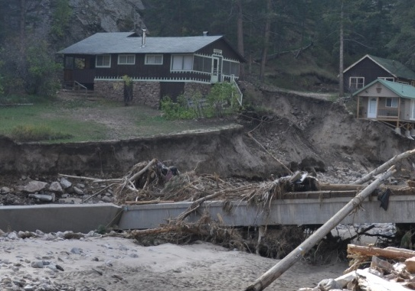
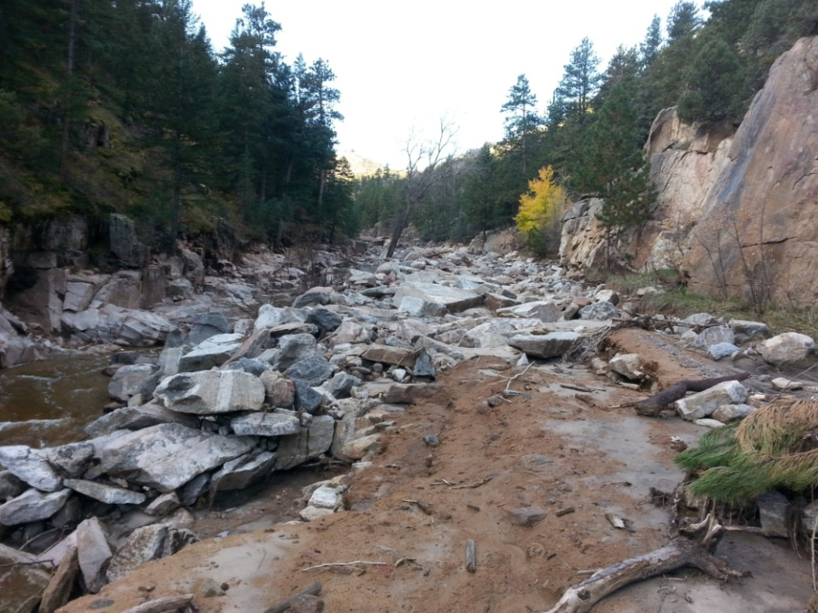
Natural Disasters – continued
2013 Flood
Widespread destruction

Slide 19
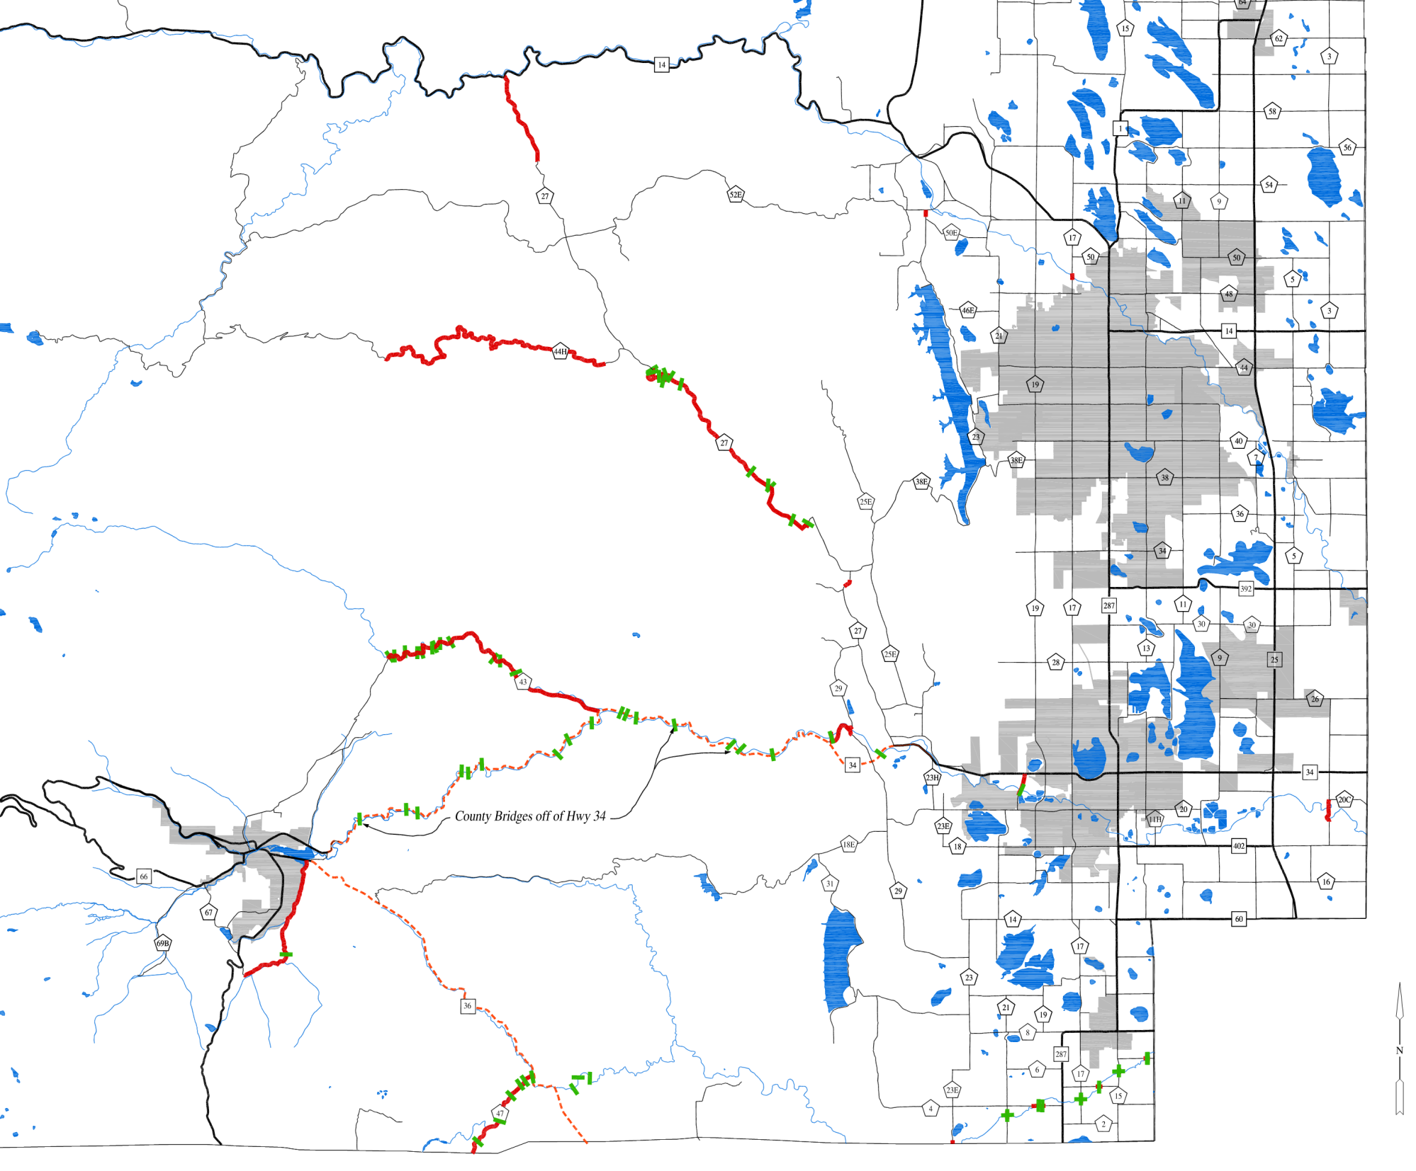
Truly
Catastrophic
Event
CR 27
Lower Buckhorn
CR 27
Fort Collins
Upper Buckhorn CR 44H
Devils’s Gulch Road
CR 43 above and below Glen Haven
Misc. Other Locations
Loveland
Big Thompson Canyon Bridges
Estes Park
Fish Creek
Road CR 63
Big Elk Meadows CR 47
Numerous
Local Road
Issues
Berthoud
Bridges over the Little Thompson
River

Slide 20
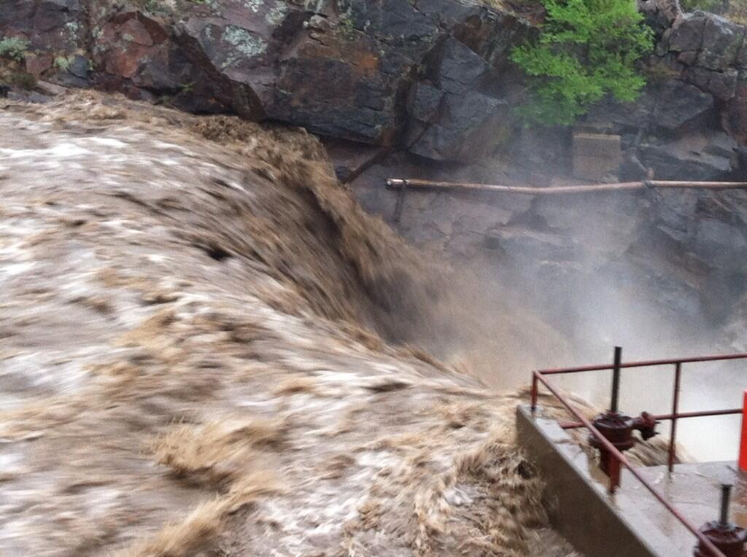
Unprecedented Countywide Damage
More than 50 bridges or large culverts damaged or destroyed
30 miles of roadway completely obliterated
2,000+ properties
without access
Repair estimate
$125 million
Flood Pic
Notes:
In comparison
‘normal year’
2-3 bridges
1-2 miles of roadway
Transportation budget $20 million

Slide 21
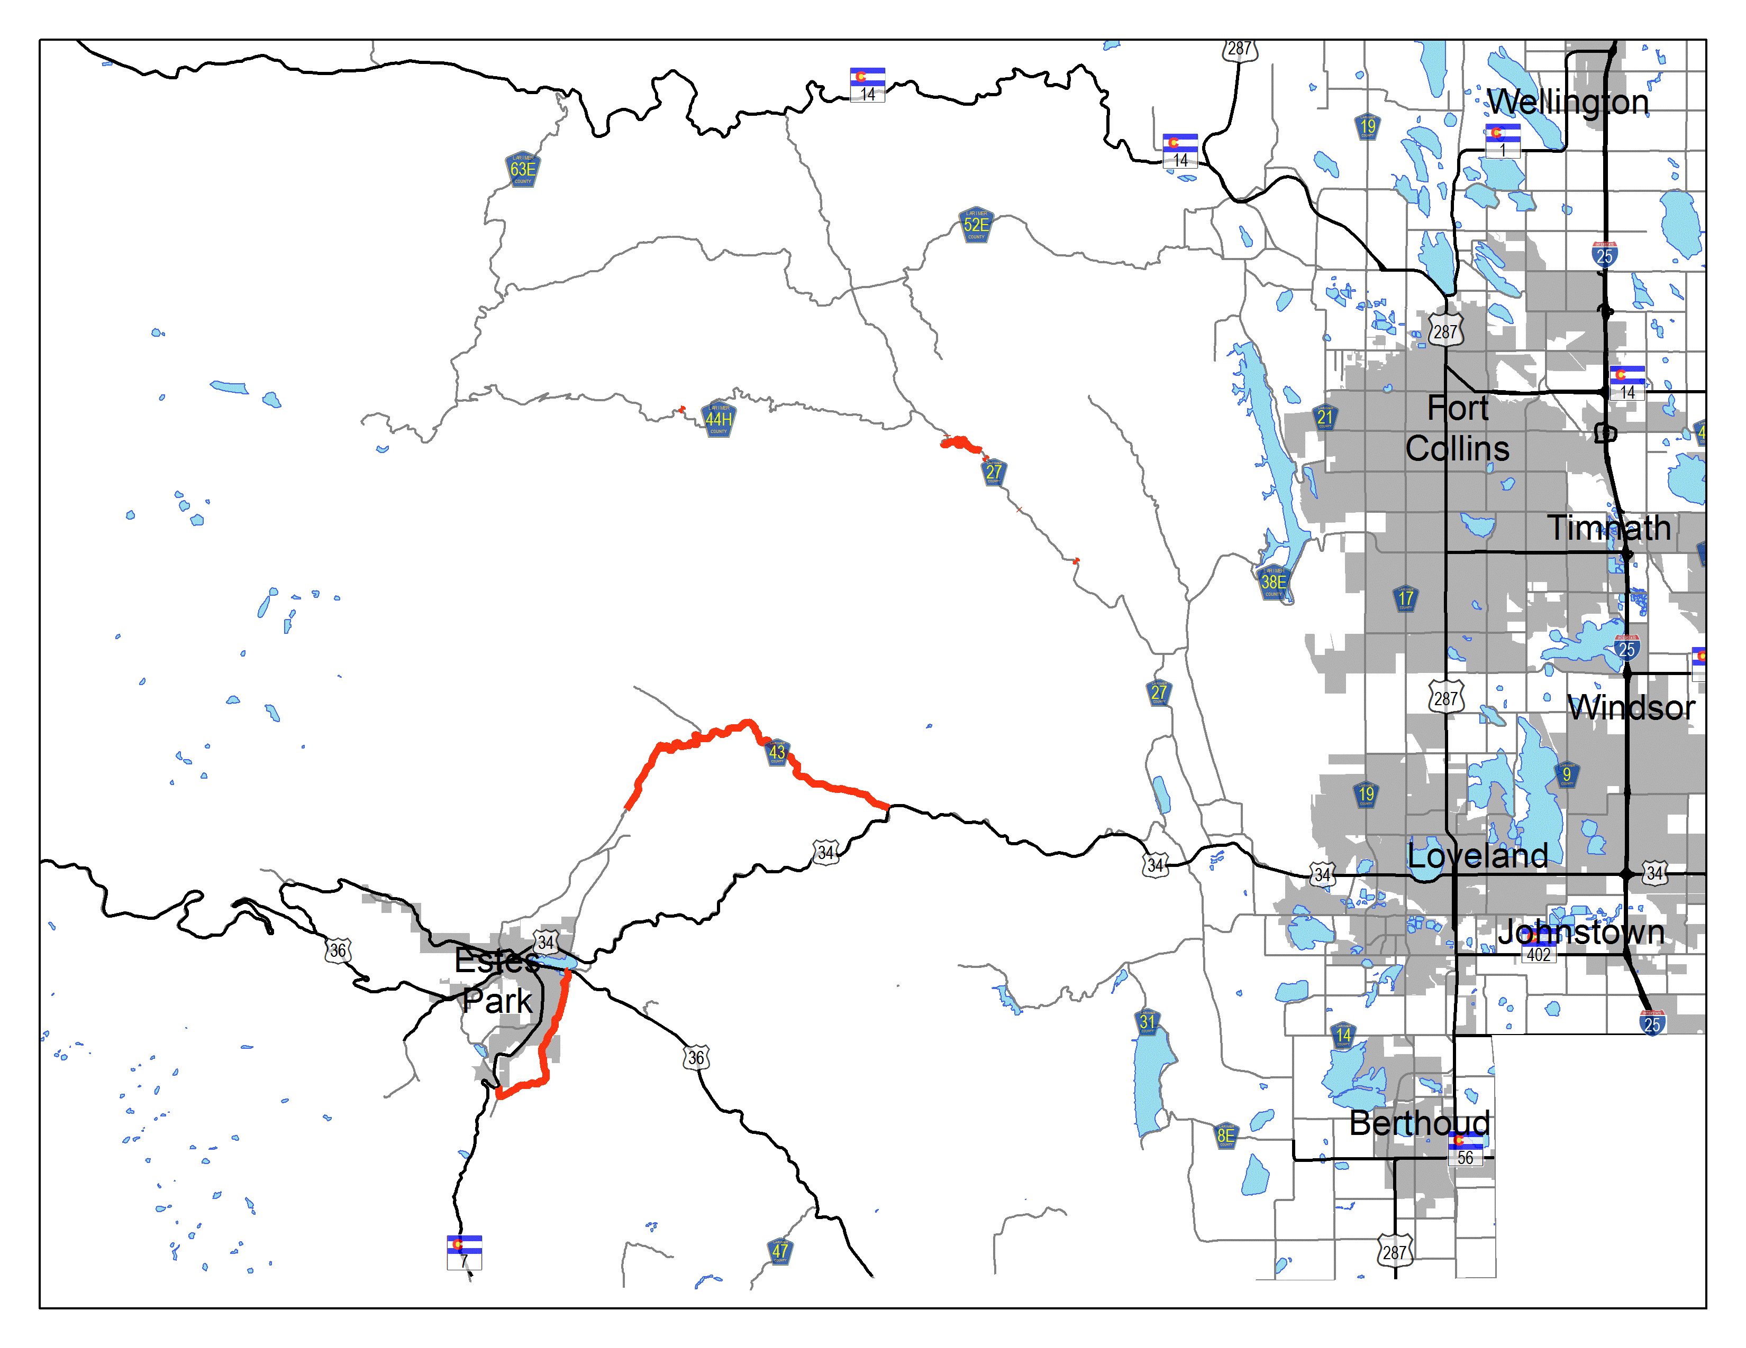
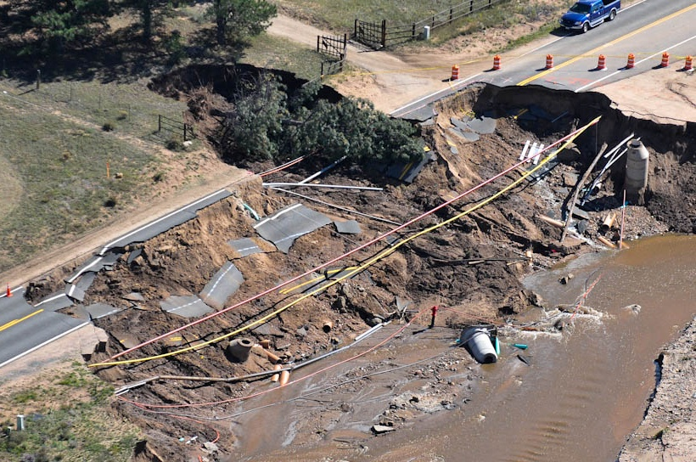
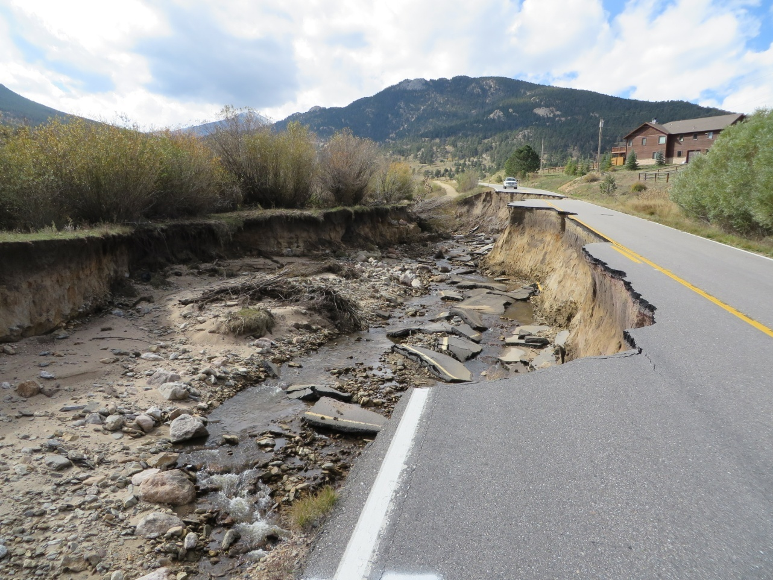
CR 63 - Fish Creek Road

Slide 22
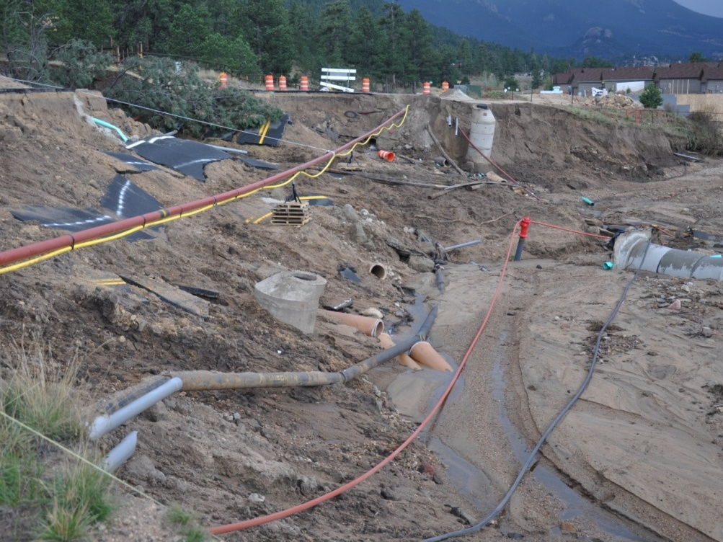
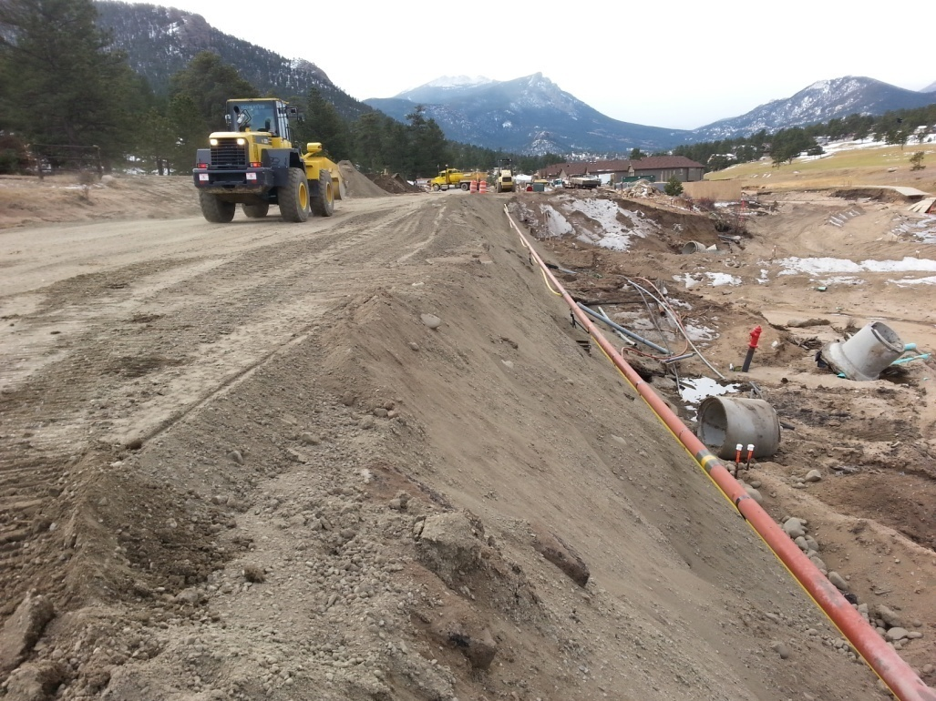
CR 63 – Fish Creek Road
Numerous agencies to coordinate work
FEMA, FHWA, CDOT, DHSEM, Estes Park, Estes Valley Park & Rec Dist., Upper Thompson Sanitation Dist.
Utilities
Road, Trail, Fish Creek Restoration
$15 million cost estimate
Notes:
Will temporary sewer line hold or will we go back to outhouses?

Slide 23
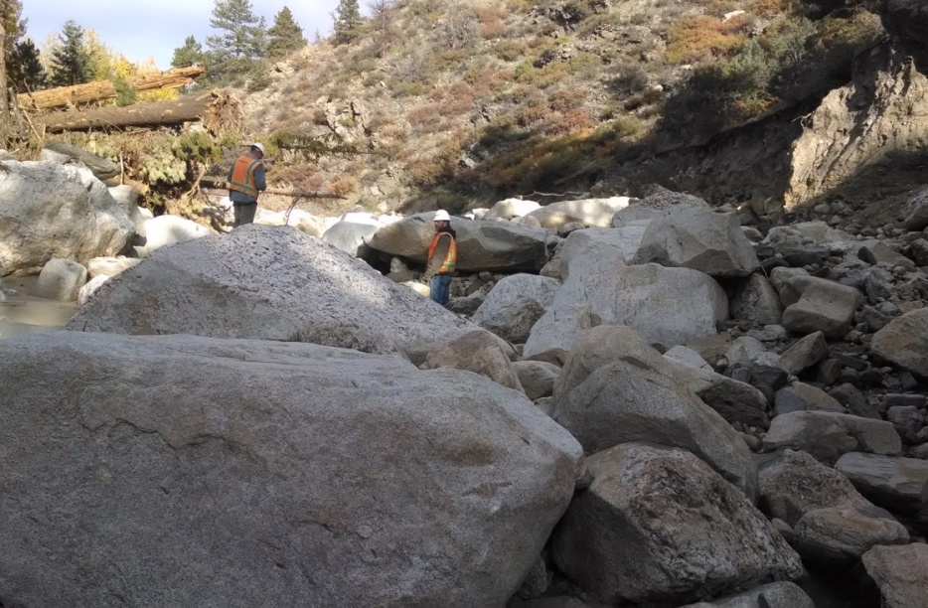
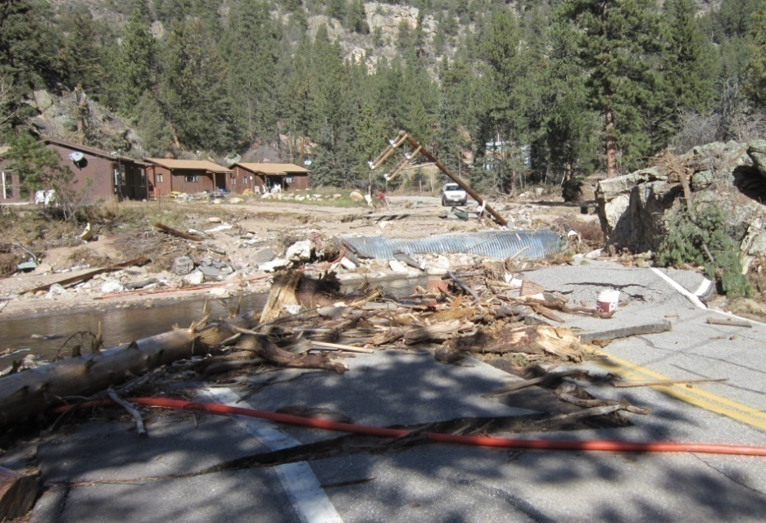
CR 43 – Glen Haven Road

Slide 24
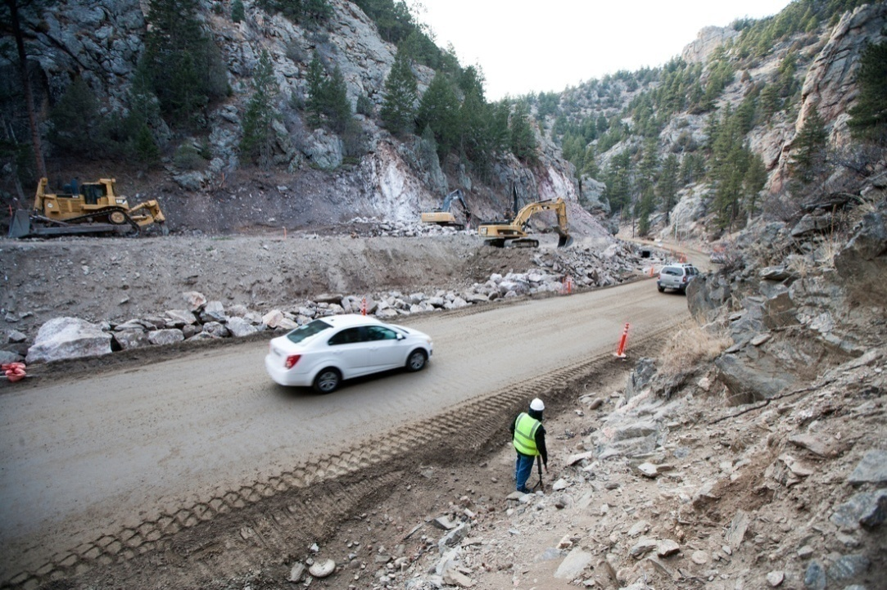
CR 43 – Glen Haven Road
10.5 miles of road
8 new structures
$40 million cost estimate
Central Federal Lands (CFL) design & construction oversight
Larimer County provided project management & acquired right-of-way

Slide 25
Regional Transportation
Work with other government agencies to collaborate on Regional Transportation
CDOT, Berthoud, Loveland, Fort Collins, Wellington, Estes Park, Windsor, Timnath, Berthoud, Johnstown
Possibly proposing a sales tax in November 2019 ballot to fund regional road needs.

Slide 26
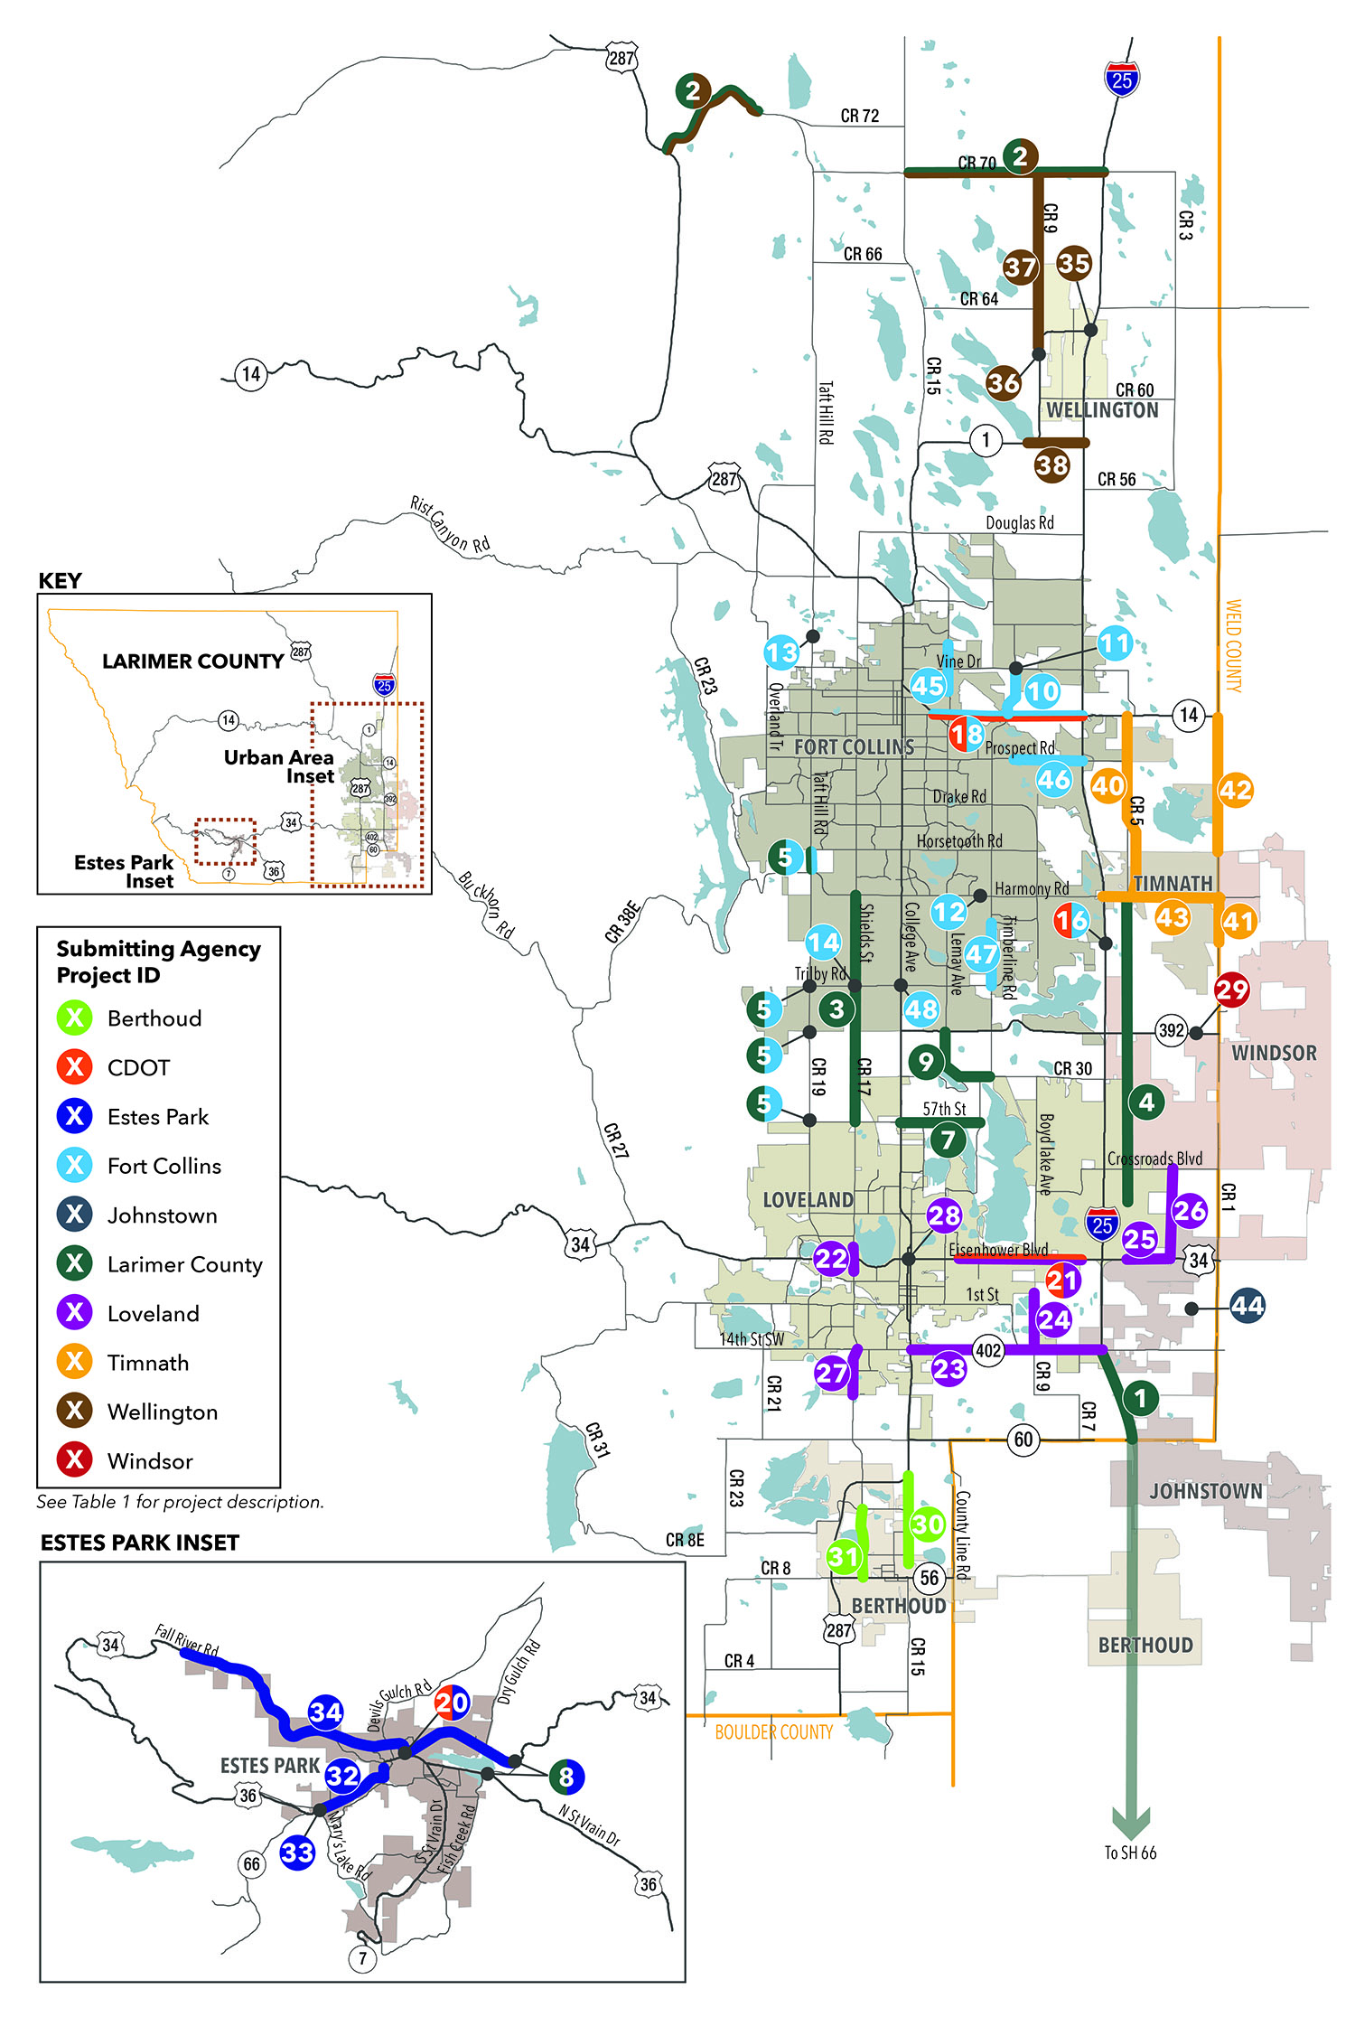
Regional Project List:
43
Projects
10
Submitting Agencies
$542M
Total Cost
Notes:
Jenny

Slide 27
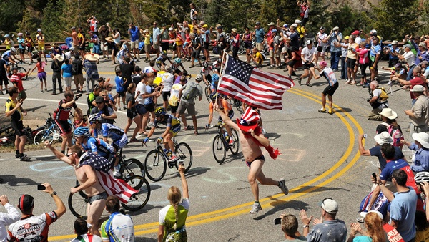
Unique Projects
Water distribution projects.
Thornton Pipeline
NISP (Northern Integrated Supply Project)
Boxelder Stormwater Basin
Special Event Permits

Slide 28
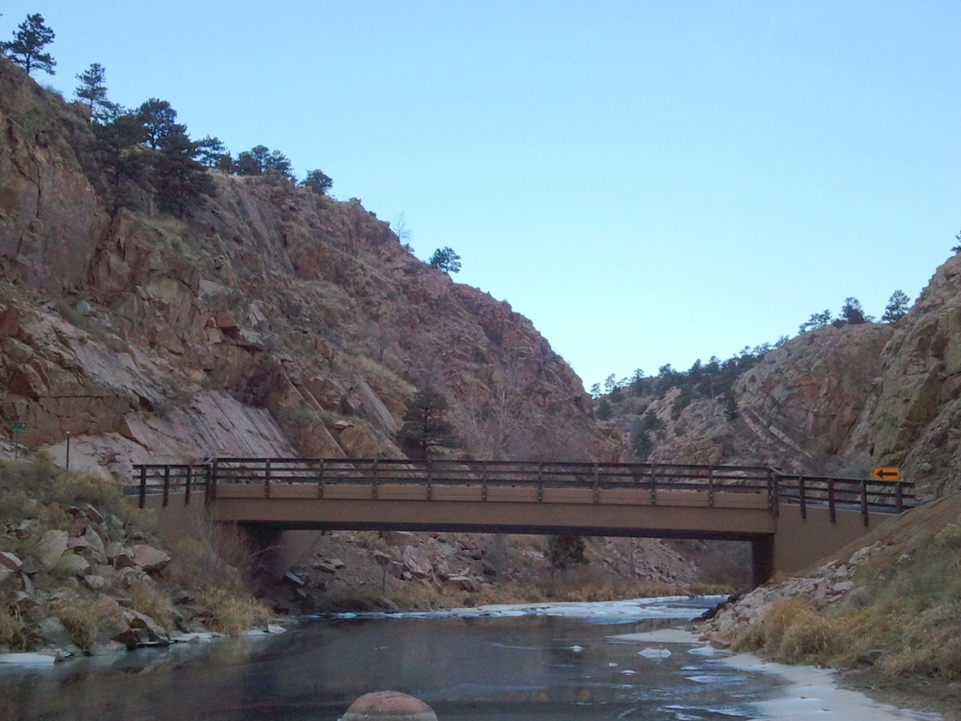
Contact Information Engineering Department
http://larimer.org/engineering
Phone / Fax (970) 498-5700 (970) 498-7986
Office Hours 8:00 a.m. - 4:30 pm Monday - Friday

