Slide 1
Larimer County: The Ranch events complex
Larimer county college 101
May 10, 2018

Slide 2
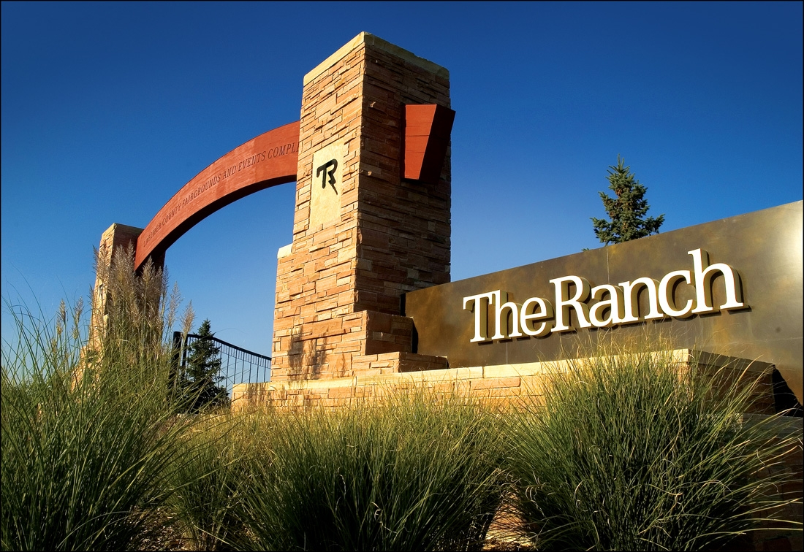
The ranch events complex

Slide 3
The ranch events complex
About us:
County owned and operated facility
Opened in September 2003
243 acre site
Four buildings on campus
Over 800,000 event attendance
Facility creates over 350 full and part time jobs
Event sales and planning
Event operations
Sales and marketing
Concessions and banquet
Administration

Slide 4
The ranch events complex
madWire Holiday party in Exhibition Hall

Slide 5
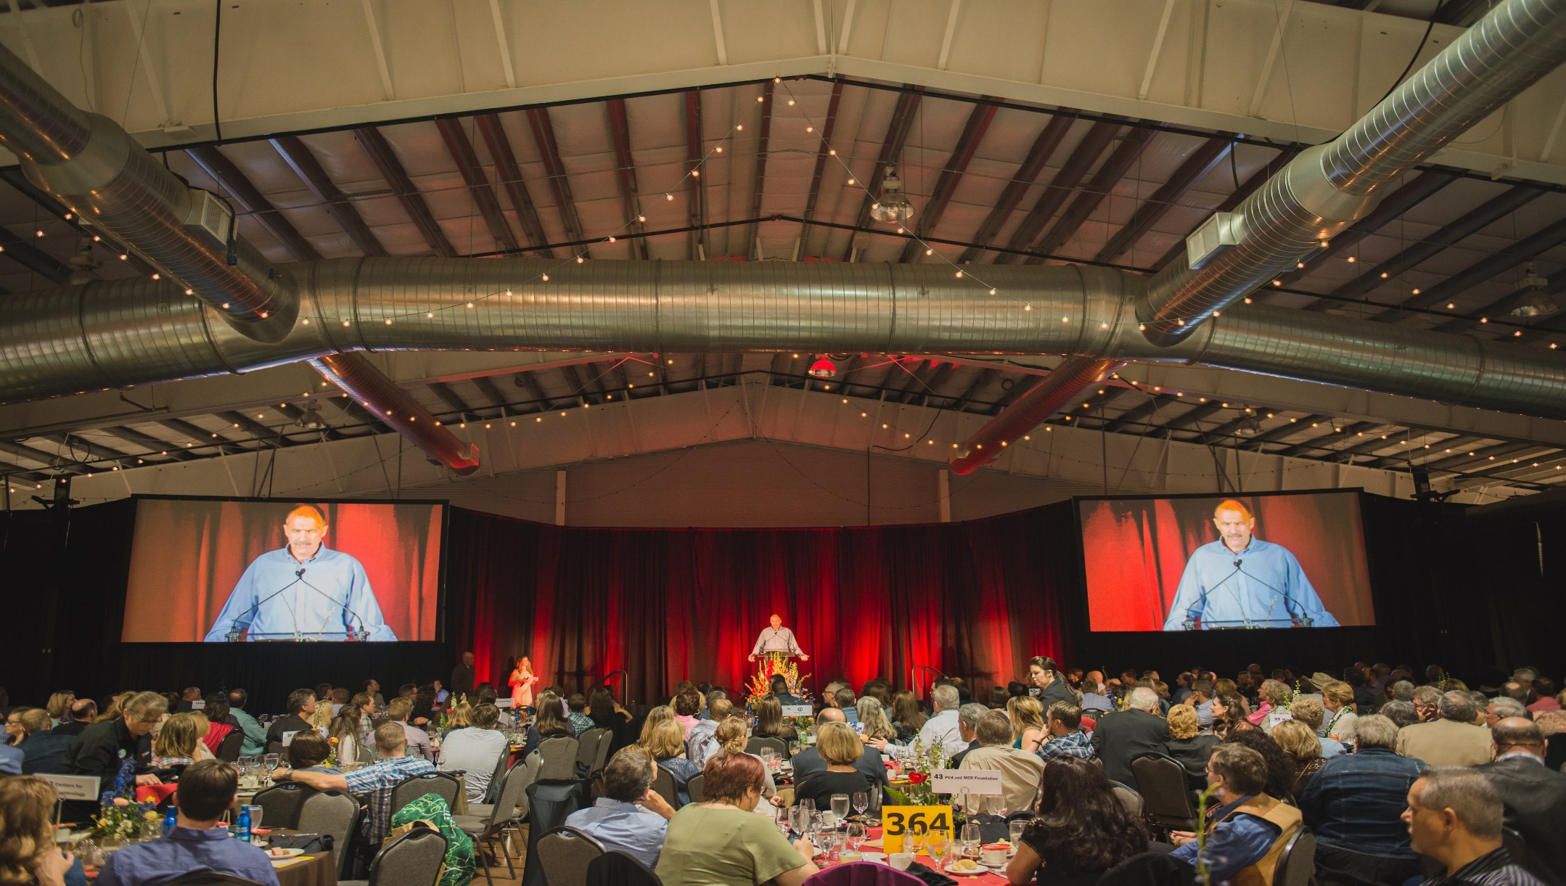
The ranch events complex
Water users meeting in exhibition hall

Slide 6
The ranch events complex
Colorado eagles hockey

Slide 7
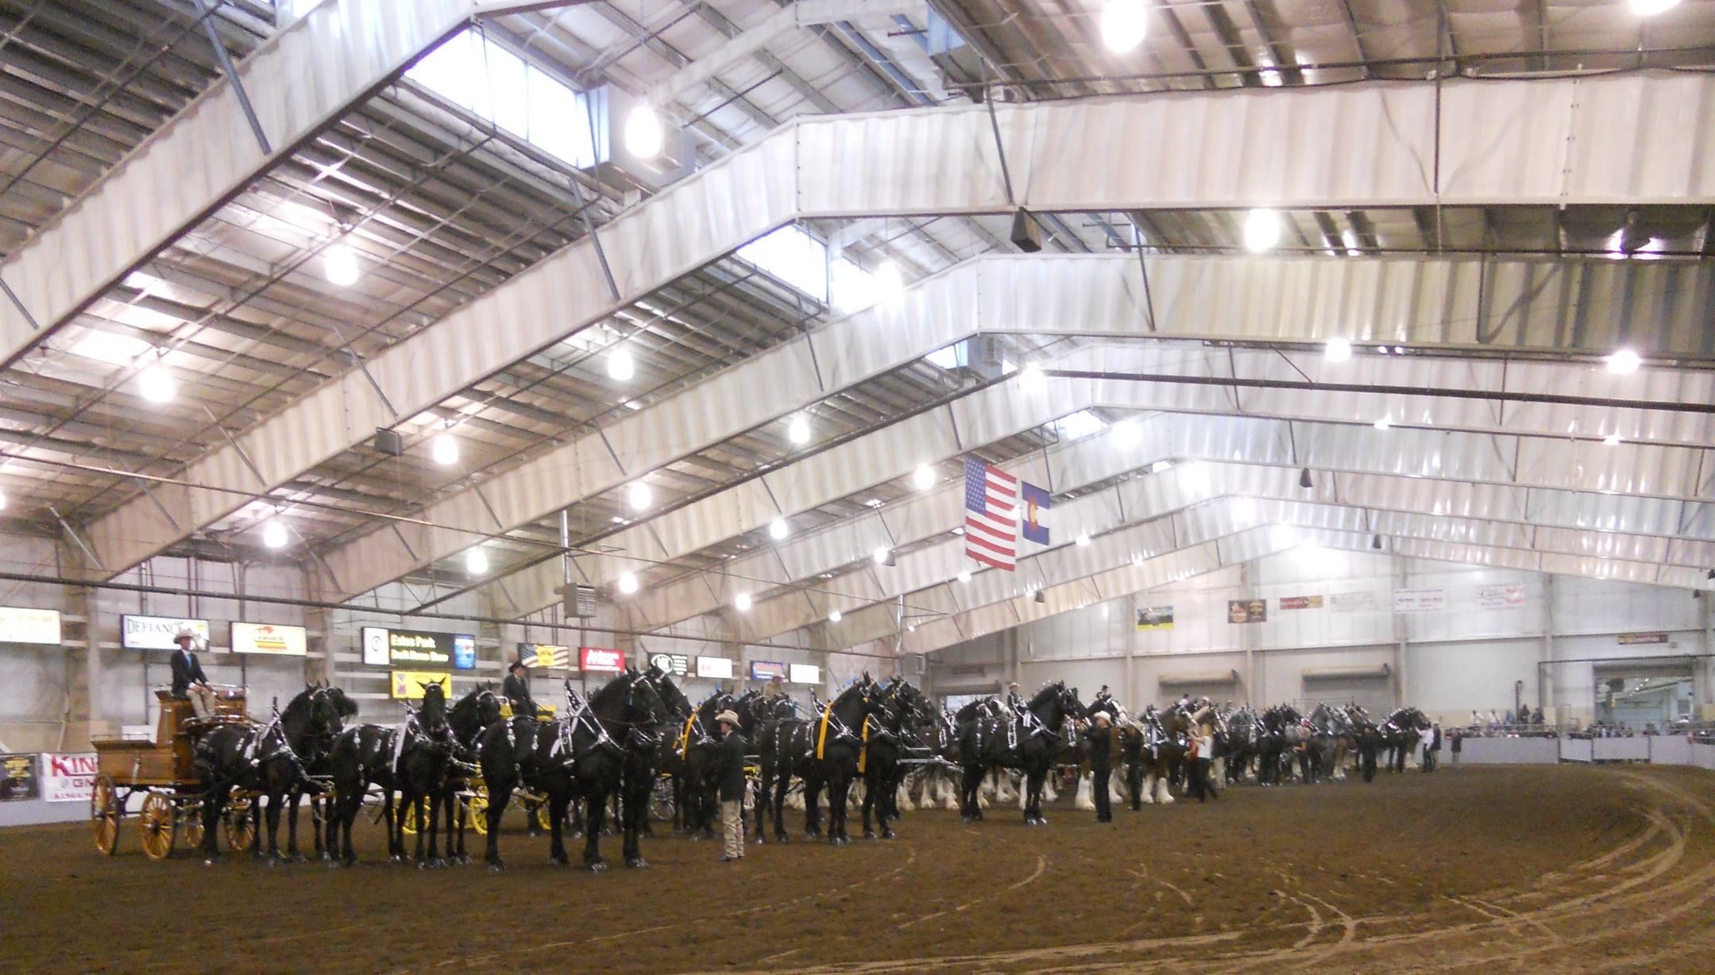
The ranch events complex
Big thunder draft horse show

Slide 8
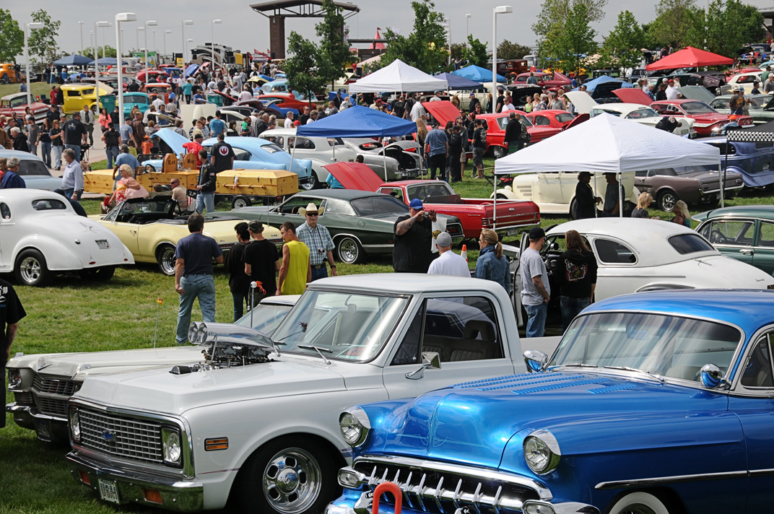
The ranch events complex
Good guys car show

Slide 9
The ranch events complex
Marketing, sponsorship, Foodservice
Sponsorship $1,708,894 in cash and trade
Marketing media, print and social media
Facebook – 35,001
Twitter – 1,775
Instagram – 776
Spectra Foodservice
Concessions $2,428,576
Catering $1,051,056

Slide 10
The ranch events complex
Special Revenue Fund
Sales tax .015 on every $100
Generate over $9M in 2017 for bond payment, operations and future capital investment
Over $11M in reserves for future capital expansion
Sales tax extended by voters in 2017 for another 20 years
Master plan
Analysis of options and define schedule
Impact on future generations

